Slide 1
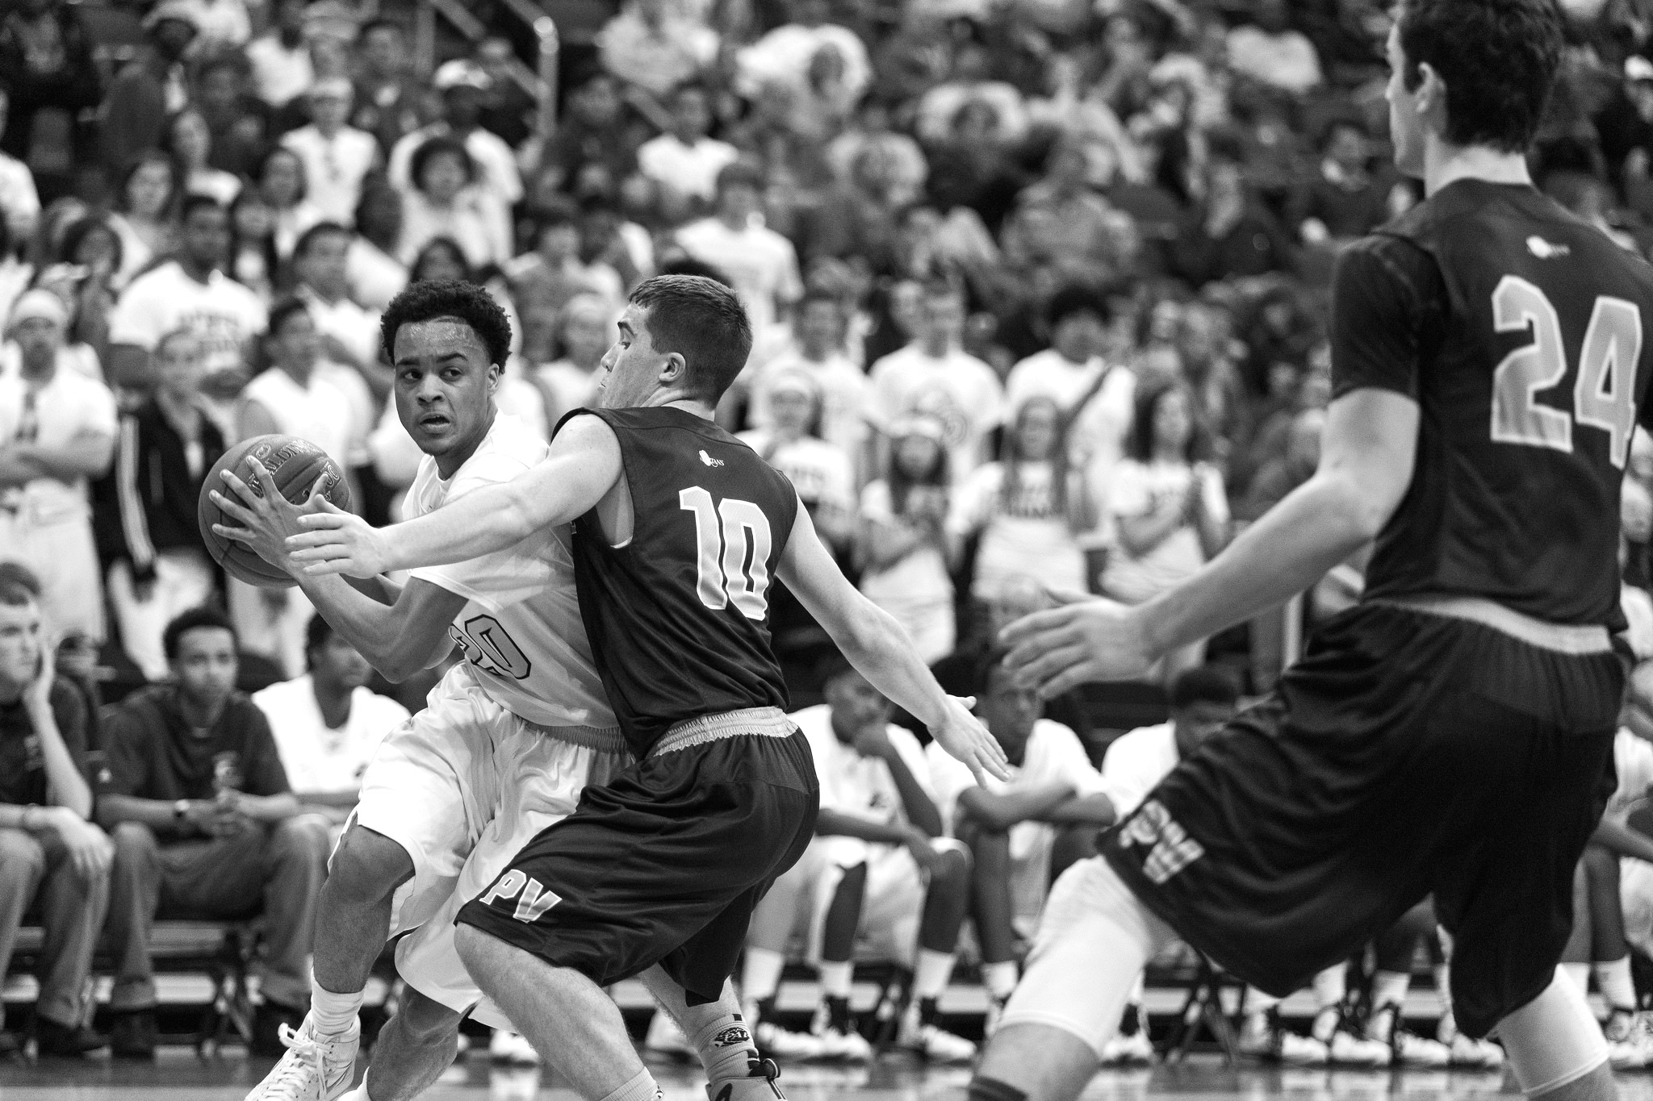

TASK
MADNESS
ON DEMAND
PROCESSING WITH
SPRING CLOUD TASK
TASK MADNESS
ON DEMAND PROCESSING WITH SCT
Notes:
https://www.flickr.com/photos/tabor-roeder/16811793545/

Slide 2
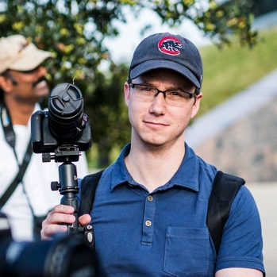
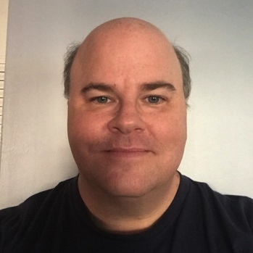
WHO ARE WE?
MICHAEL MINELLA
@michaelminella
@OffHeap
Github: mminella
https://www.spring.io
GLENN RENFRO
@cppwfs
Github: cppwfs
https://www.spring.io

Slide 3
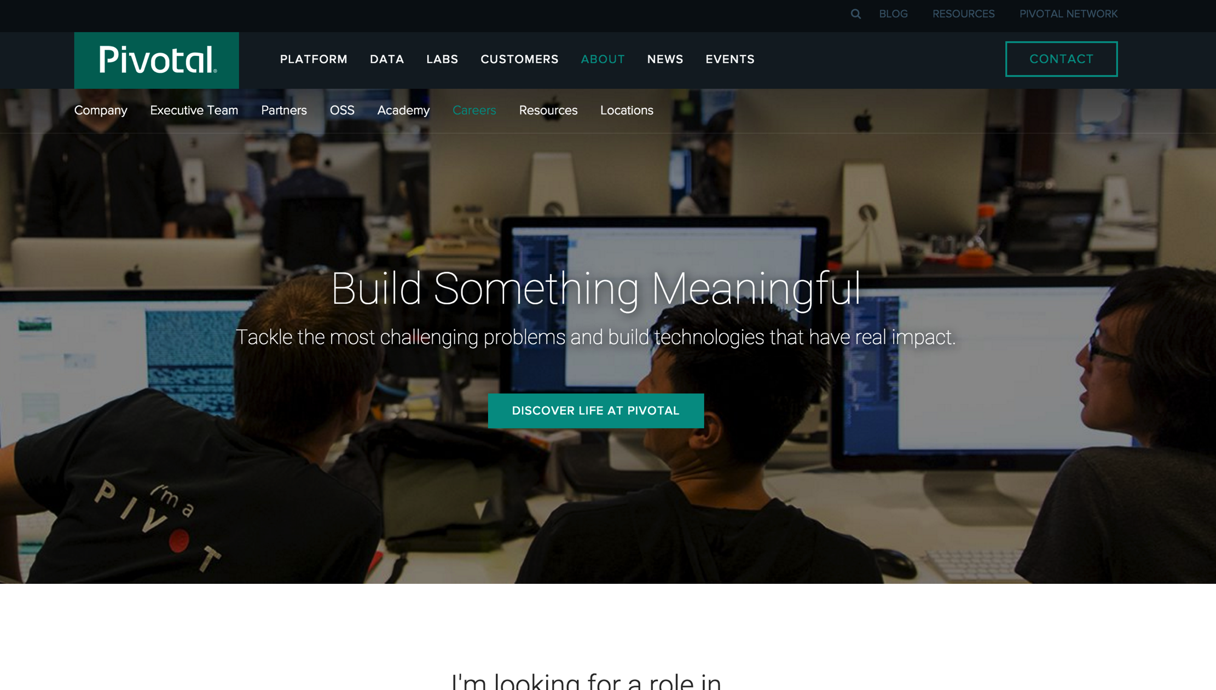

Slide 4
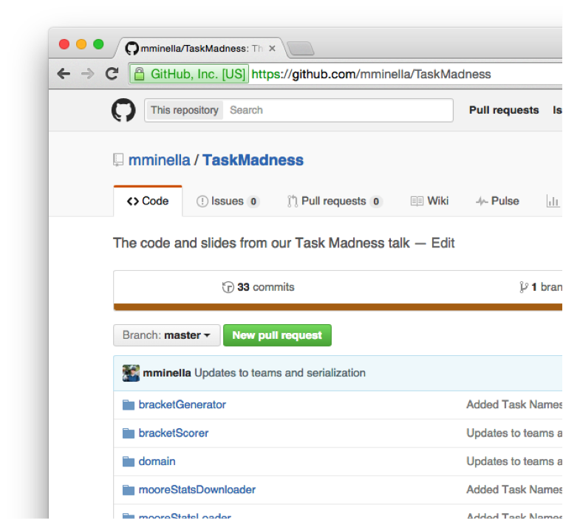

CODE IS ON GITHUB
https://github.com/mminella/TaskMadness

Slide 5
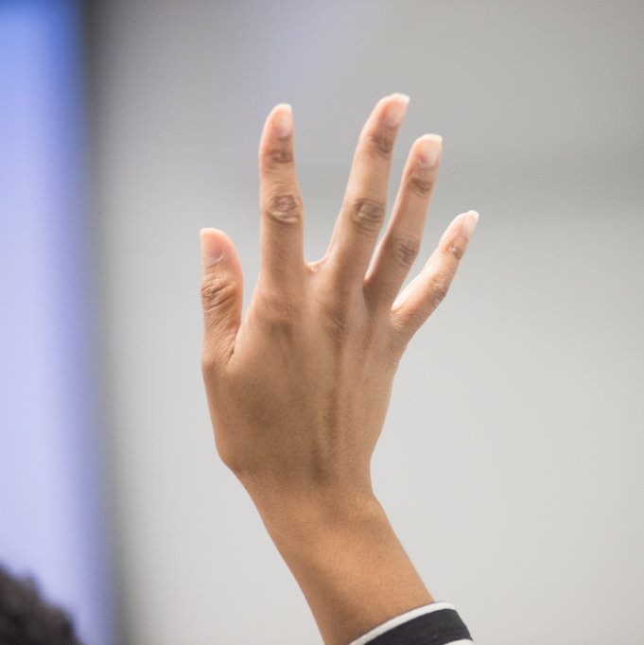
PLEASE ASK
QUESTIONS

Slide 6


QUICK
POLL

Slide 7
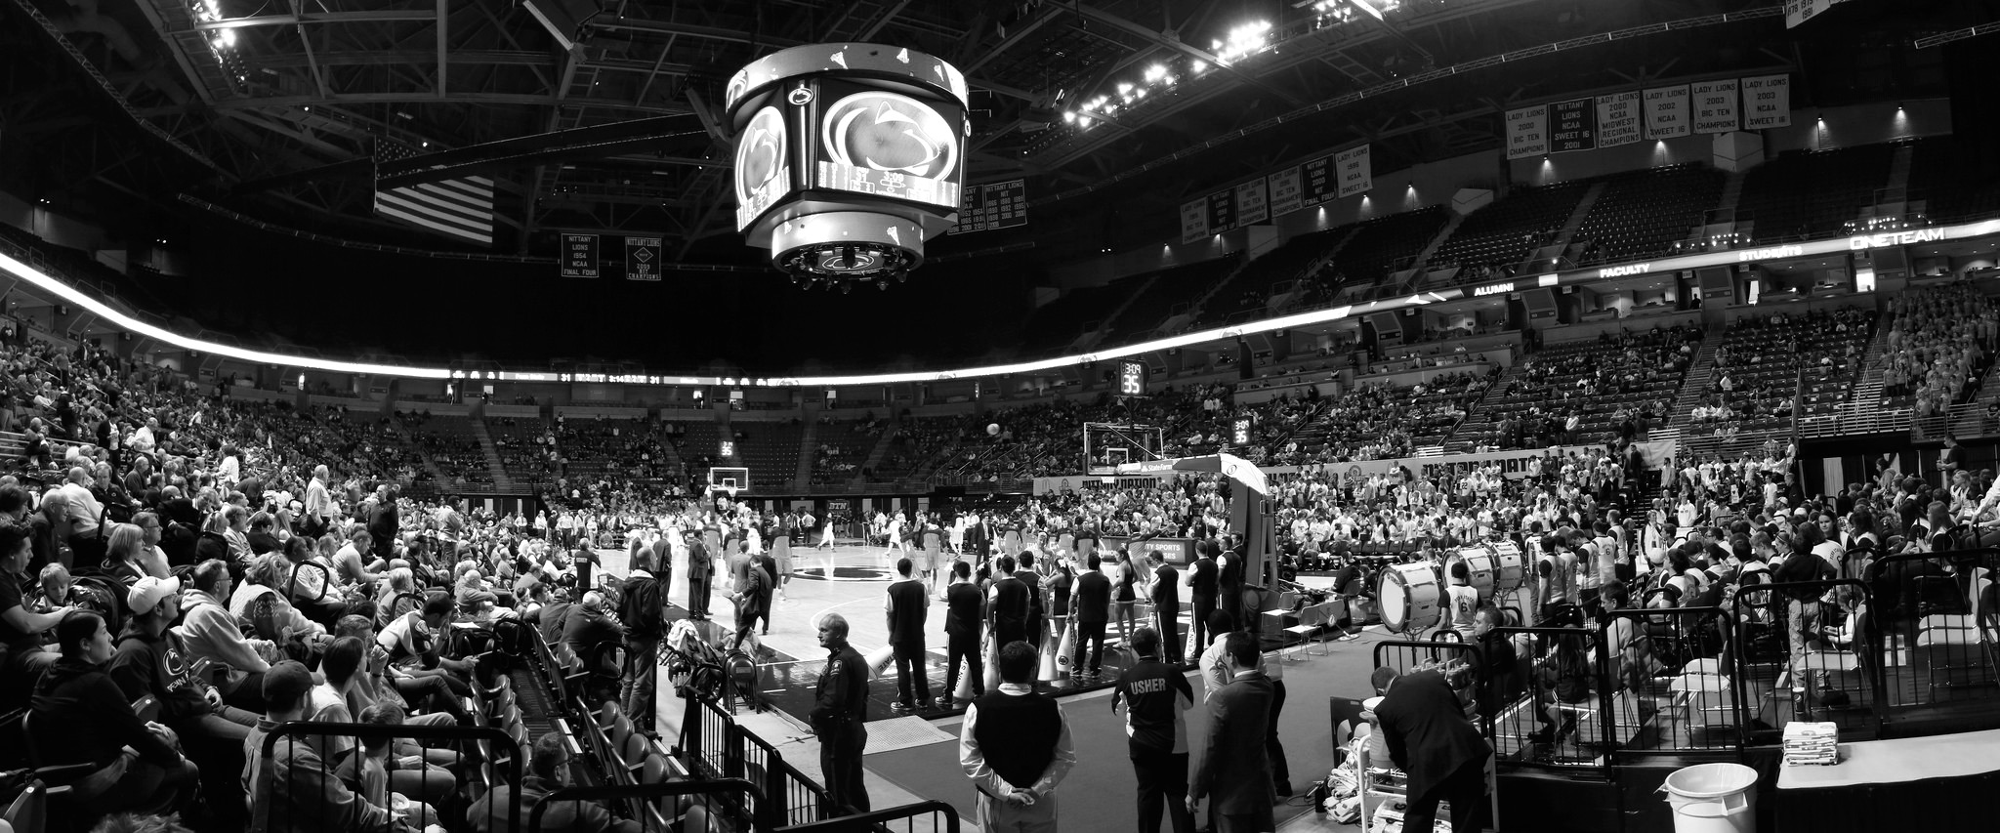
NCAA
MEN’S
BASKETBALL
TOURNAMENT
NCAA Tournament
Notes:
https://www.flickr.com/photos/yuan2003/12959533413/

Slide 8
$376 Million
vs
$1.1 Billion
13 Million
$9 Billion+
Notes:
$ 376 Million dollars spent on ads for the Super Bowl in 2016 vs $ 1.1 billion for adds in march madness
13 million brackets submitted to ESPN in 2016 - http://espnmediazone.com/us/press-releases/2016/03/espn-tournament-challenge-12-xx-million-brackets-set-new-all-time-record/
$ 9 billion dollars bet on March Madness in 2016 - http://www.marketwatch.com/story/this-is-how-much-americans-will-spend-betting-on-march-madness-games-2016-03-16

Slide 9
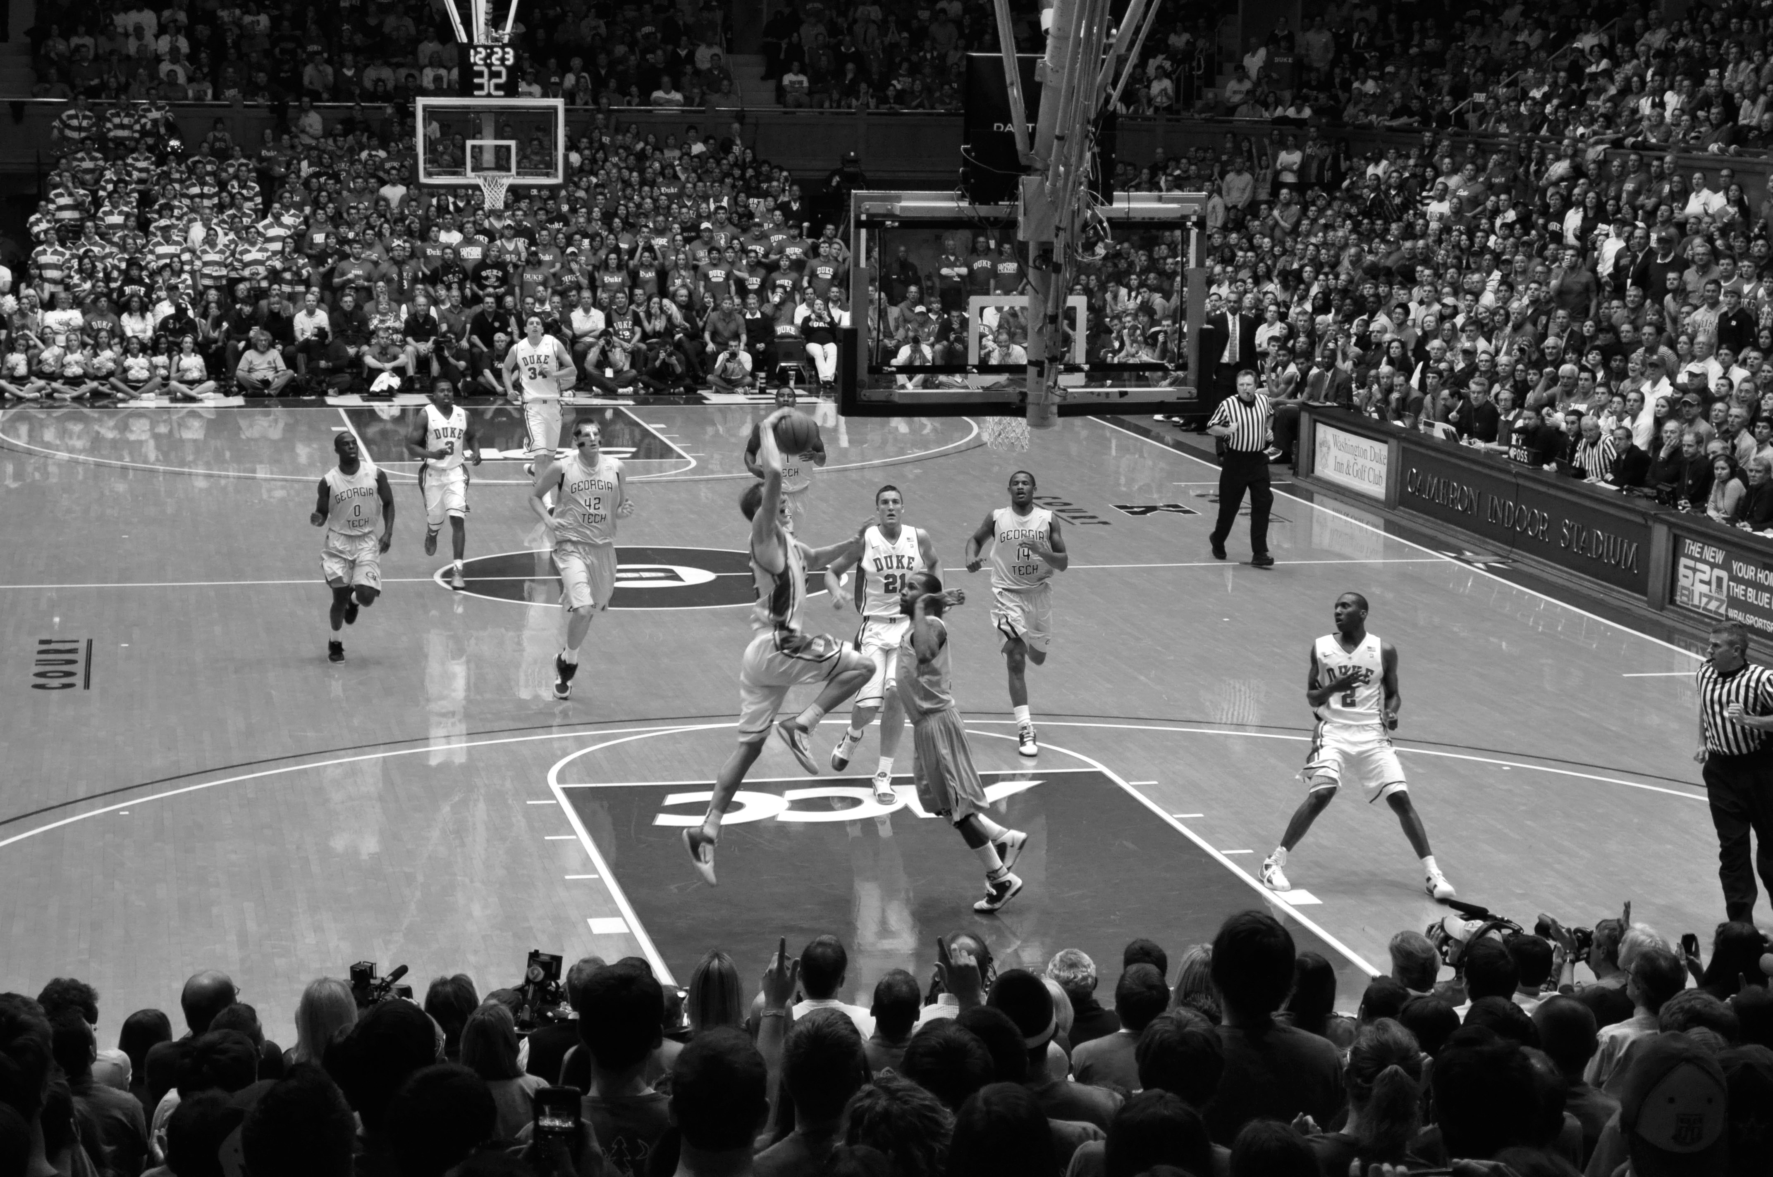

ABOUT THE
TOURNAMENT
Notes:
https://www.flickr.com/photos/whateyesee13/5472188211/

Slide 10
64
TEAMS

Slide 11
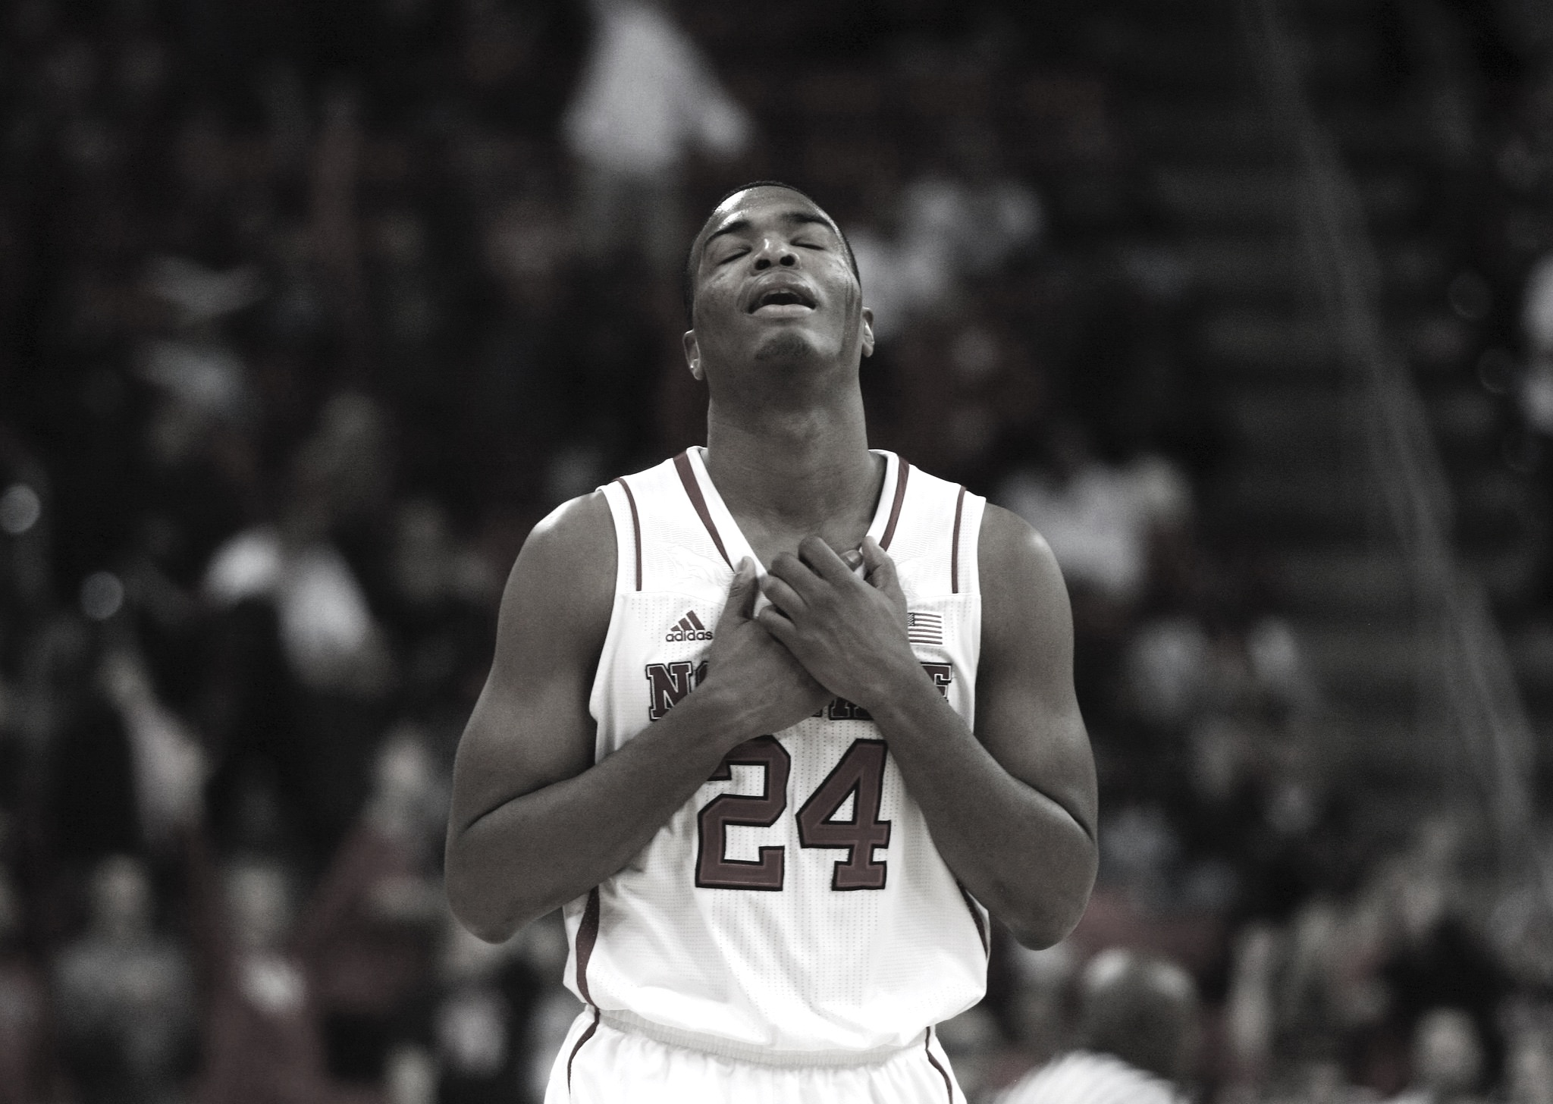

Single elimination
SINGLE
ELIMINATION
Notes:
https://www.flickr.com/photos/romec1/12229748395/

Slide 12
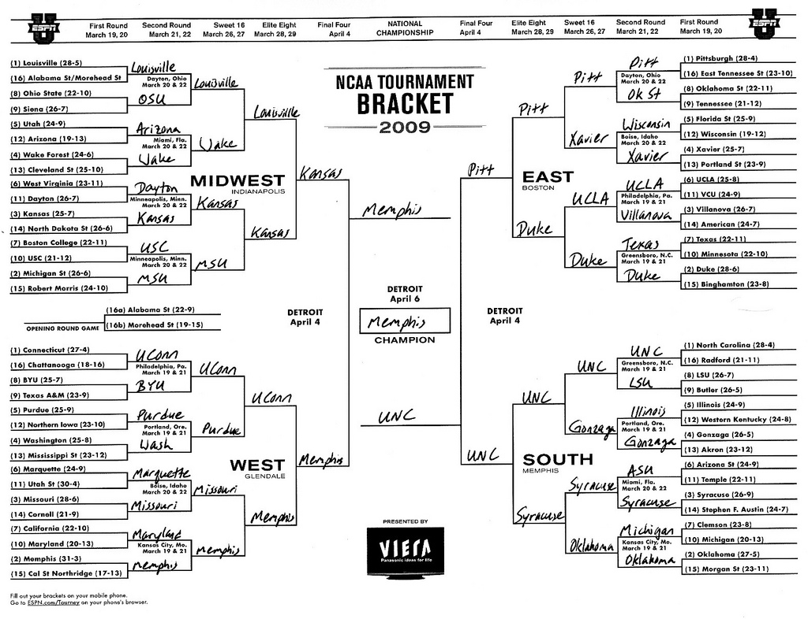
TEAMS
ARE
SEEDED
Teams are seeded

Slide 13
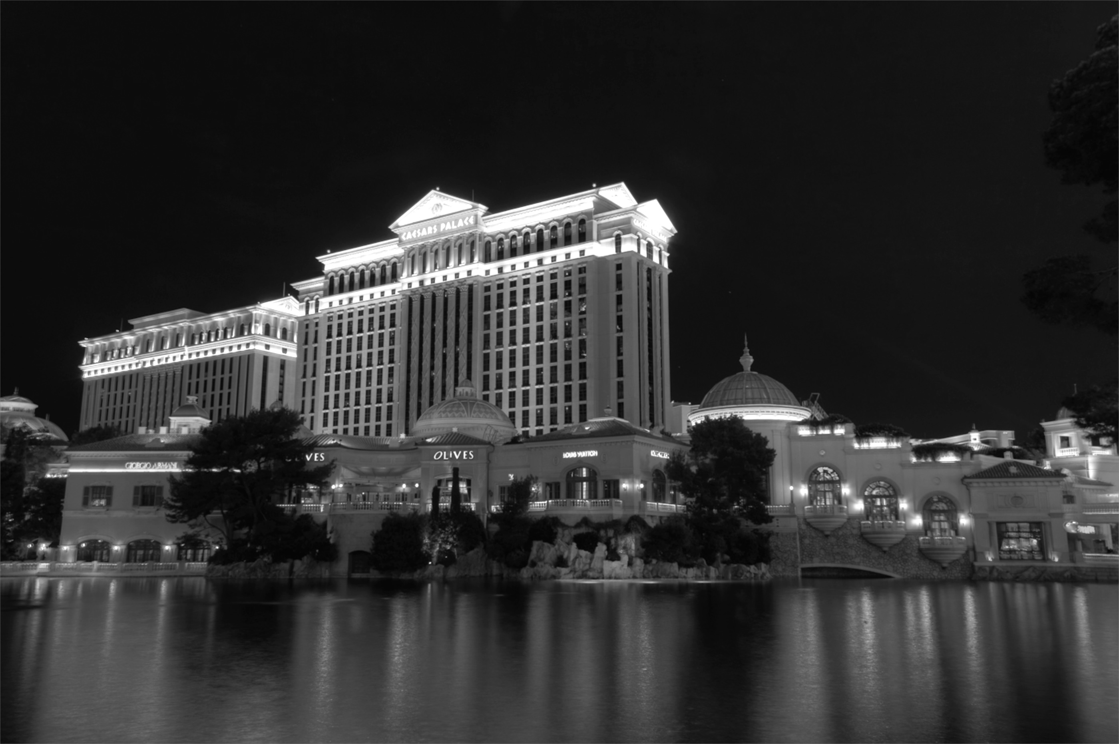

GAMBLING
BASED ON
BRACKETS
Notes:
http://keepingitrealsports.com/wp-content/uploads/2015/03/Obama-Katz.jpg

Slide 14

Not that hard right?
PICK
A PERFECT
BRACKET…
EASY RIGHT?

Slide 15
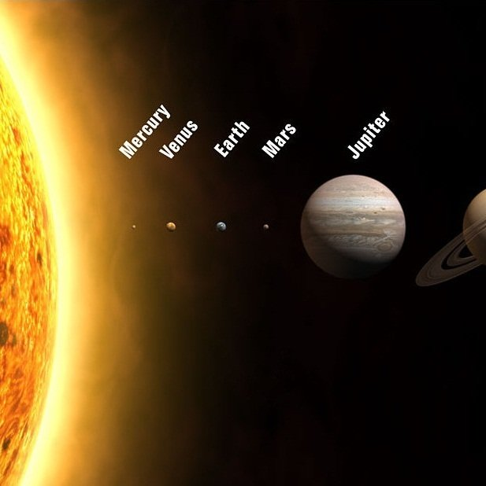
1 IN
9.2 QUINTILIAN
Notes:
Stack $1 dollar bills on top of each other and it is enough to span the solar system…84 times!

Slide 16

NOT
PERFECT
JUST
GOOD
ENOUGH
Notes:
https://www.flickr.com/photos/86530412@N02/7987532186/

Slide 17

WHAT IS
“GOOD
ENOUGH”?

Slide 18
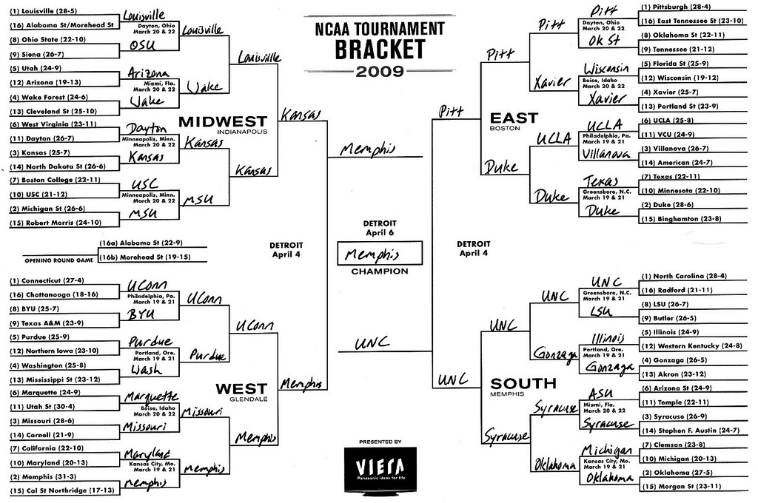

ESPN SCORING RULES
SCORING
RULES

Slide 19
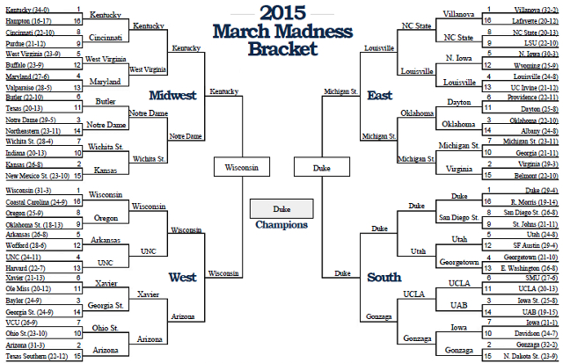
Notes:
3 #1 seeds made the final 4
A #7 seed was the other (that was the “odd” part).
#1 seed (Duke) won

Slide 20

PERFECT
BRACKET IS
1920
Notes:
320 per round * 6 rounds

Slide 21
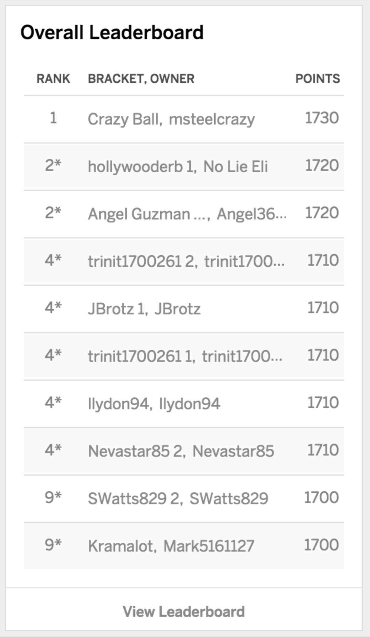

WINNER
SCORED 1730

Slide 22
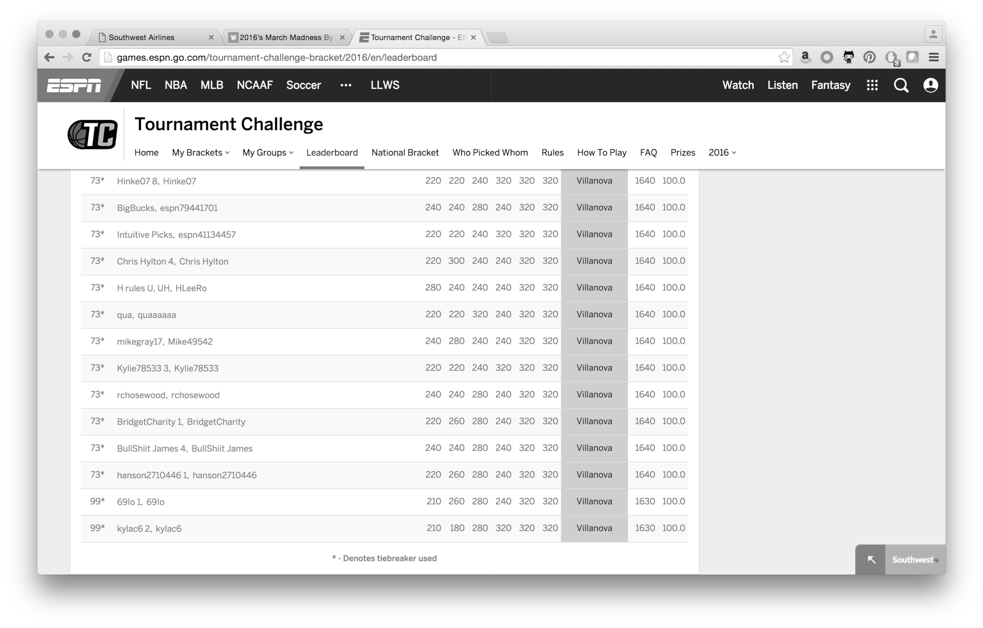
TOP 100
SCORED 1630
Notes:
Top 100 out of 11 million brackets
2014, a much crazier year…The winner had 1730 and to break the top 100, you needed a 1520

Slide 23
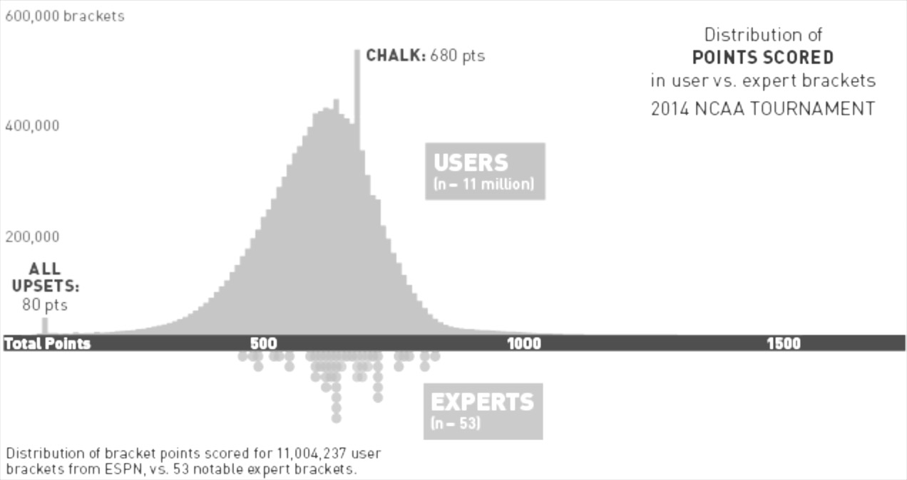

SCORES
TYPICALLY
HAVE A TIGHT
BELL CURVE

Slide 24
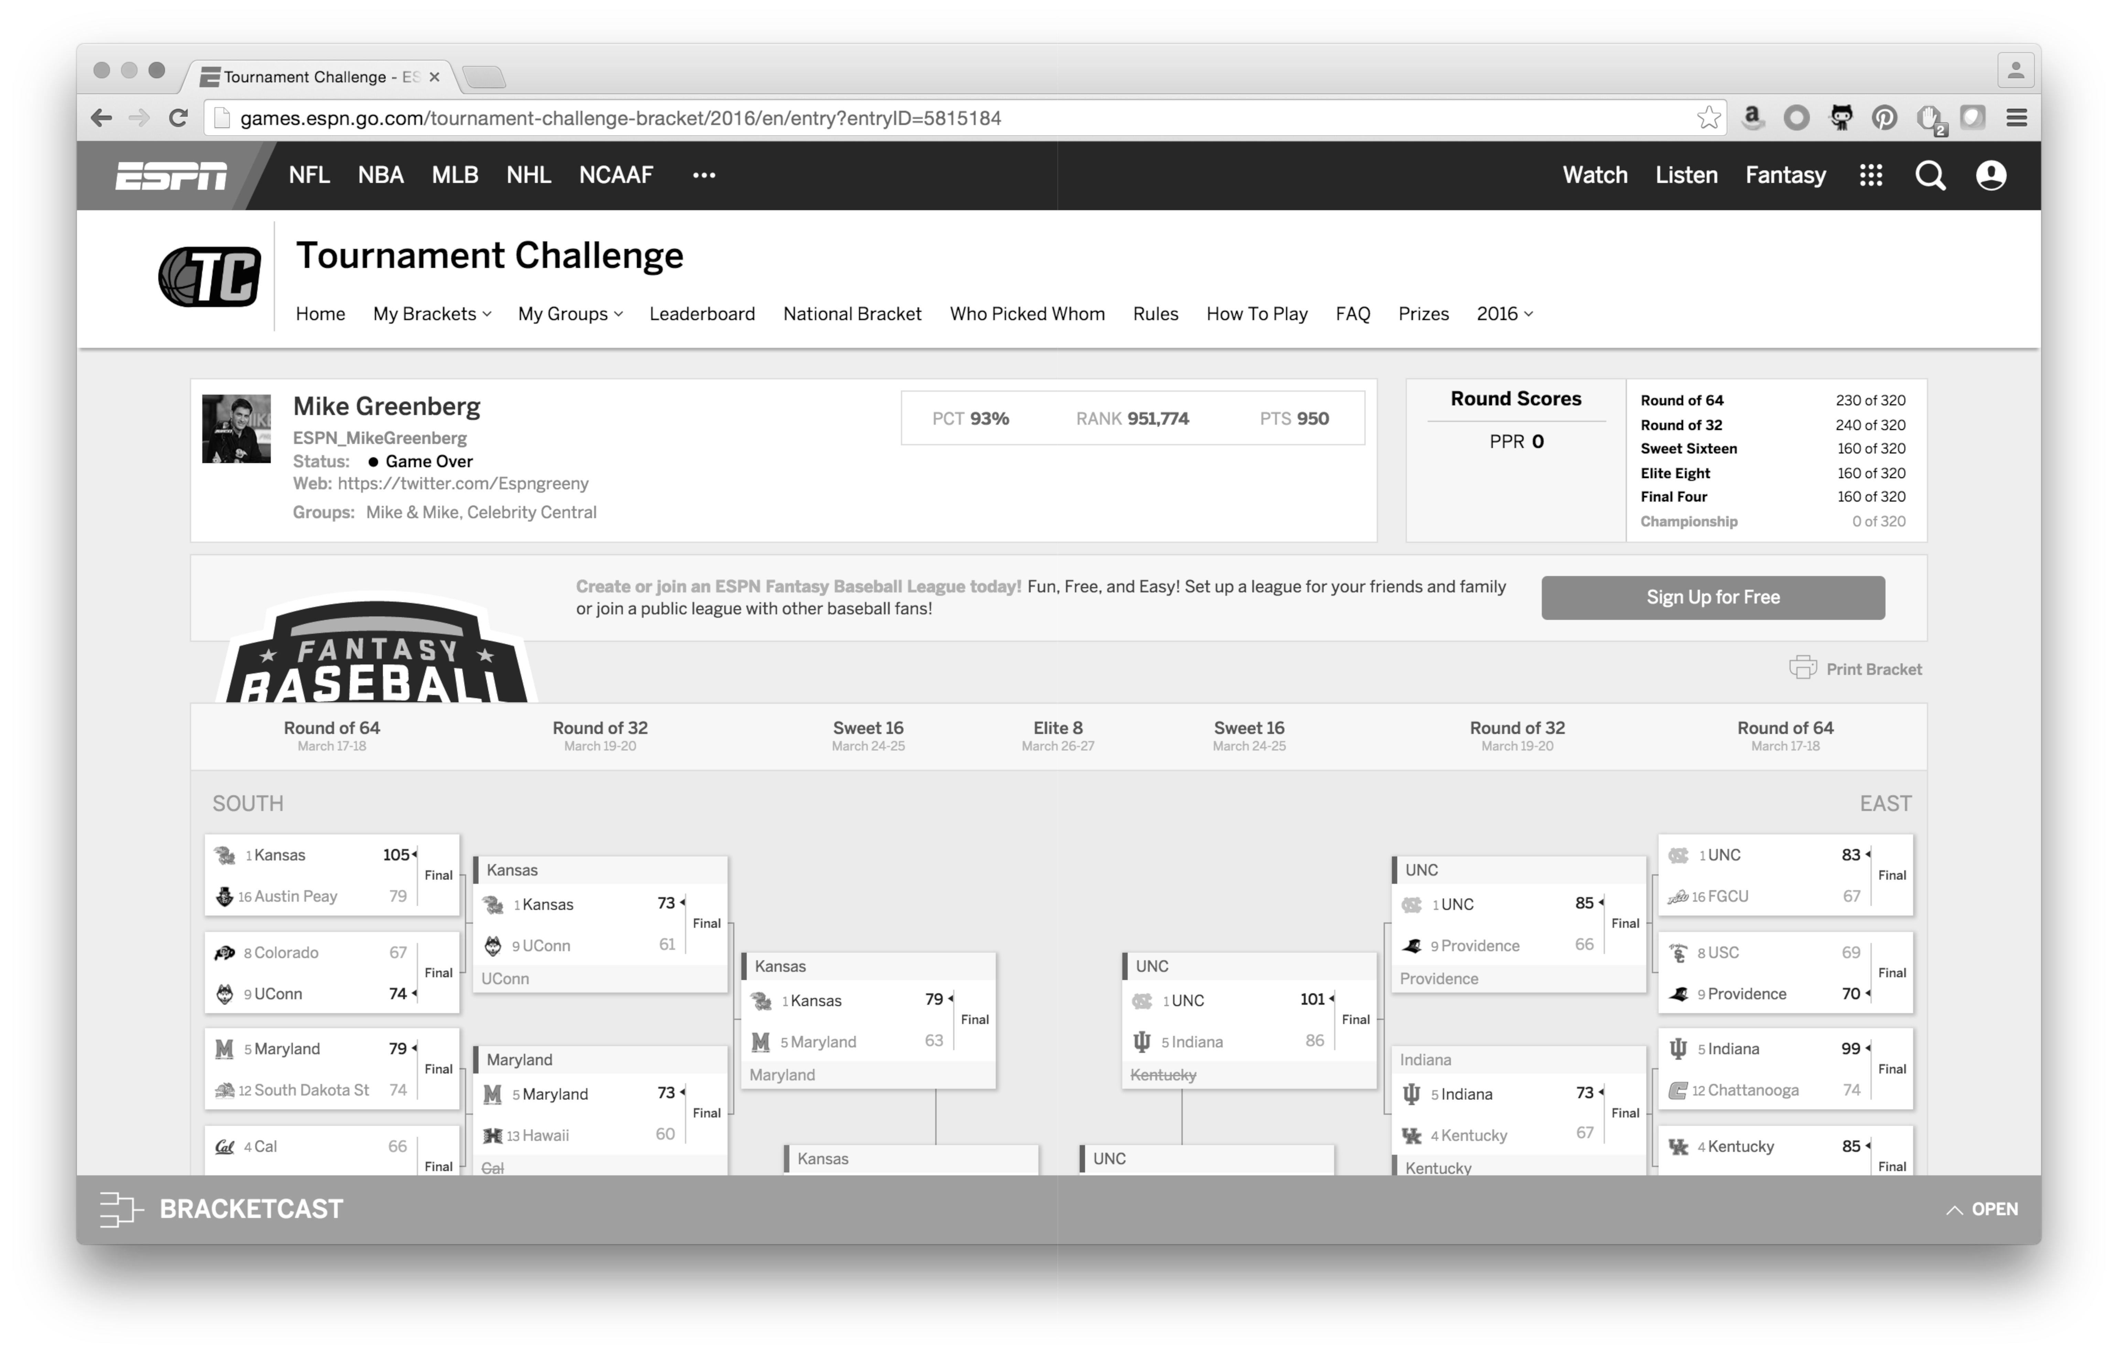
MIKE
GREENBERG
950
Joe Lunardi scored 760 in 2015 and 600 in 2014
Notes:
http://games.espn.go.com/tournament-challenge-bracket/2016/en/entry?entryID=5815184
93%

Slide 25

NOT LOOKING FOR A
PERFECT BRACKET

Slide 26
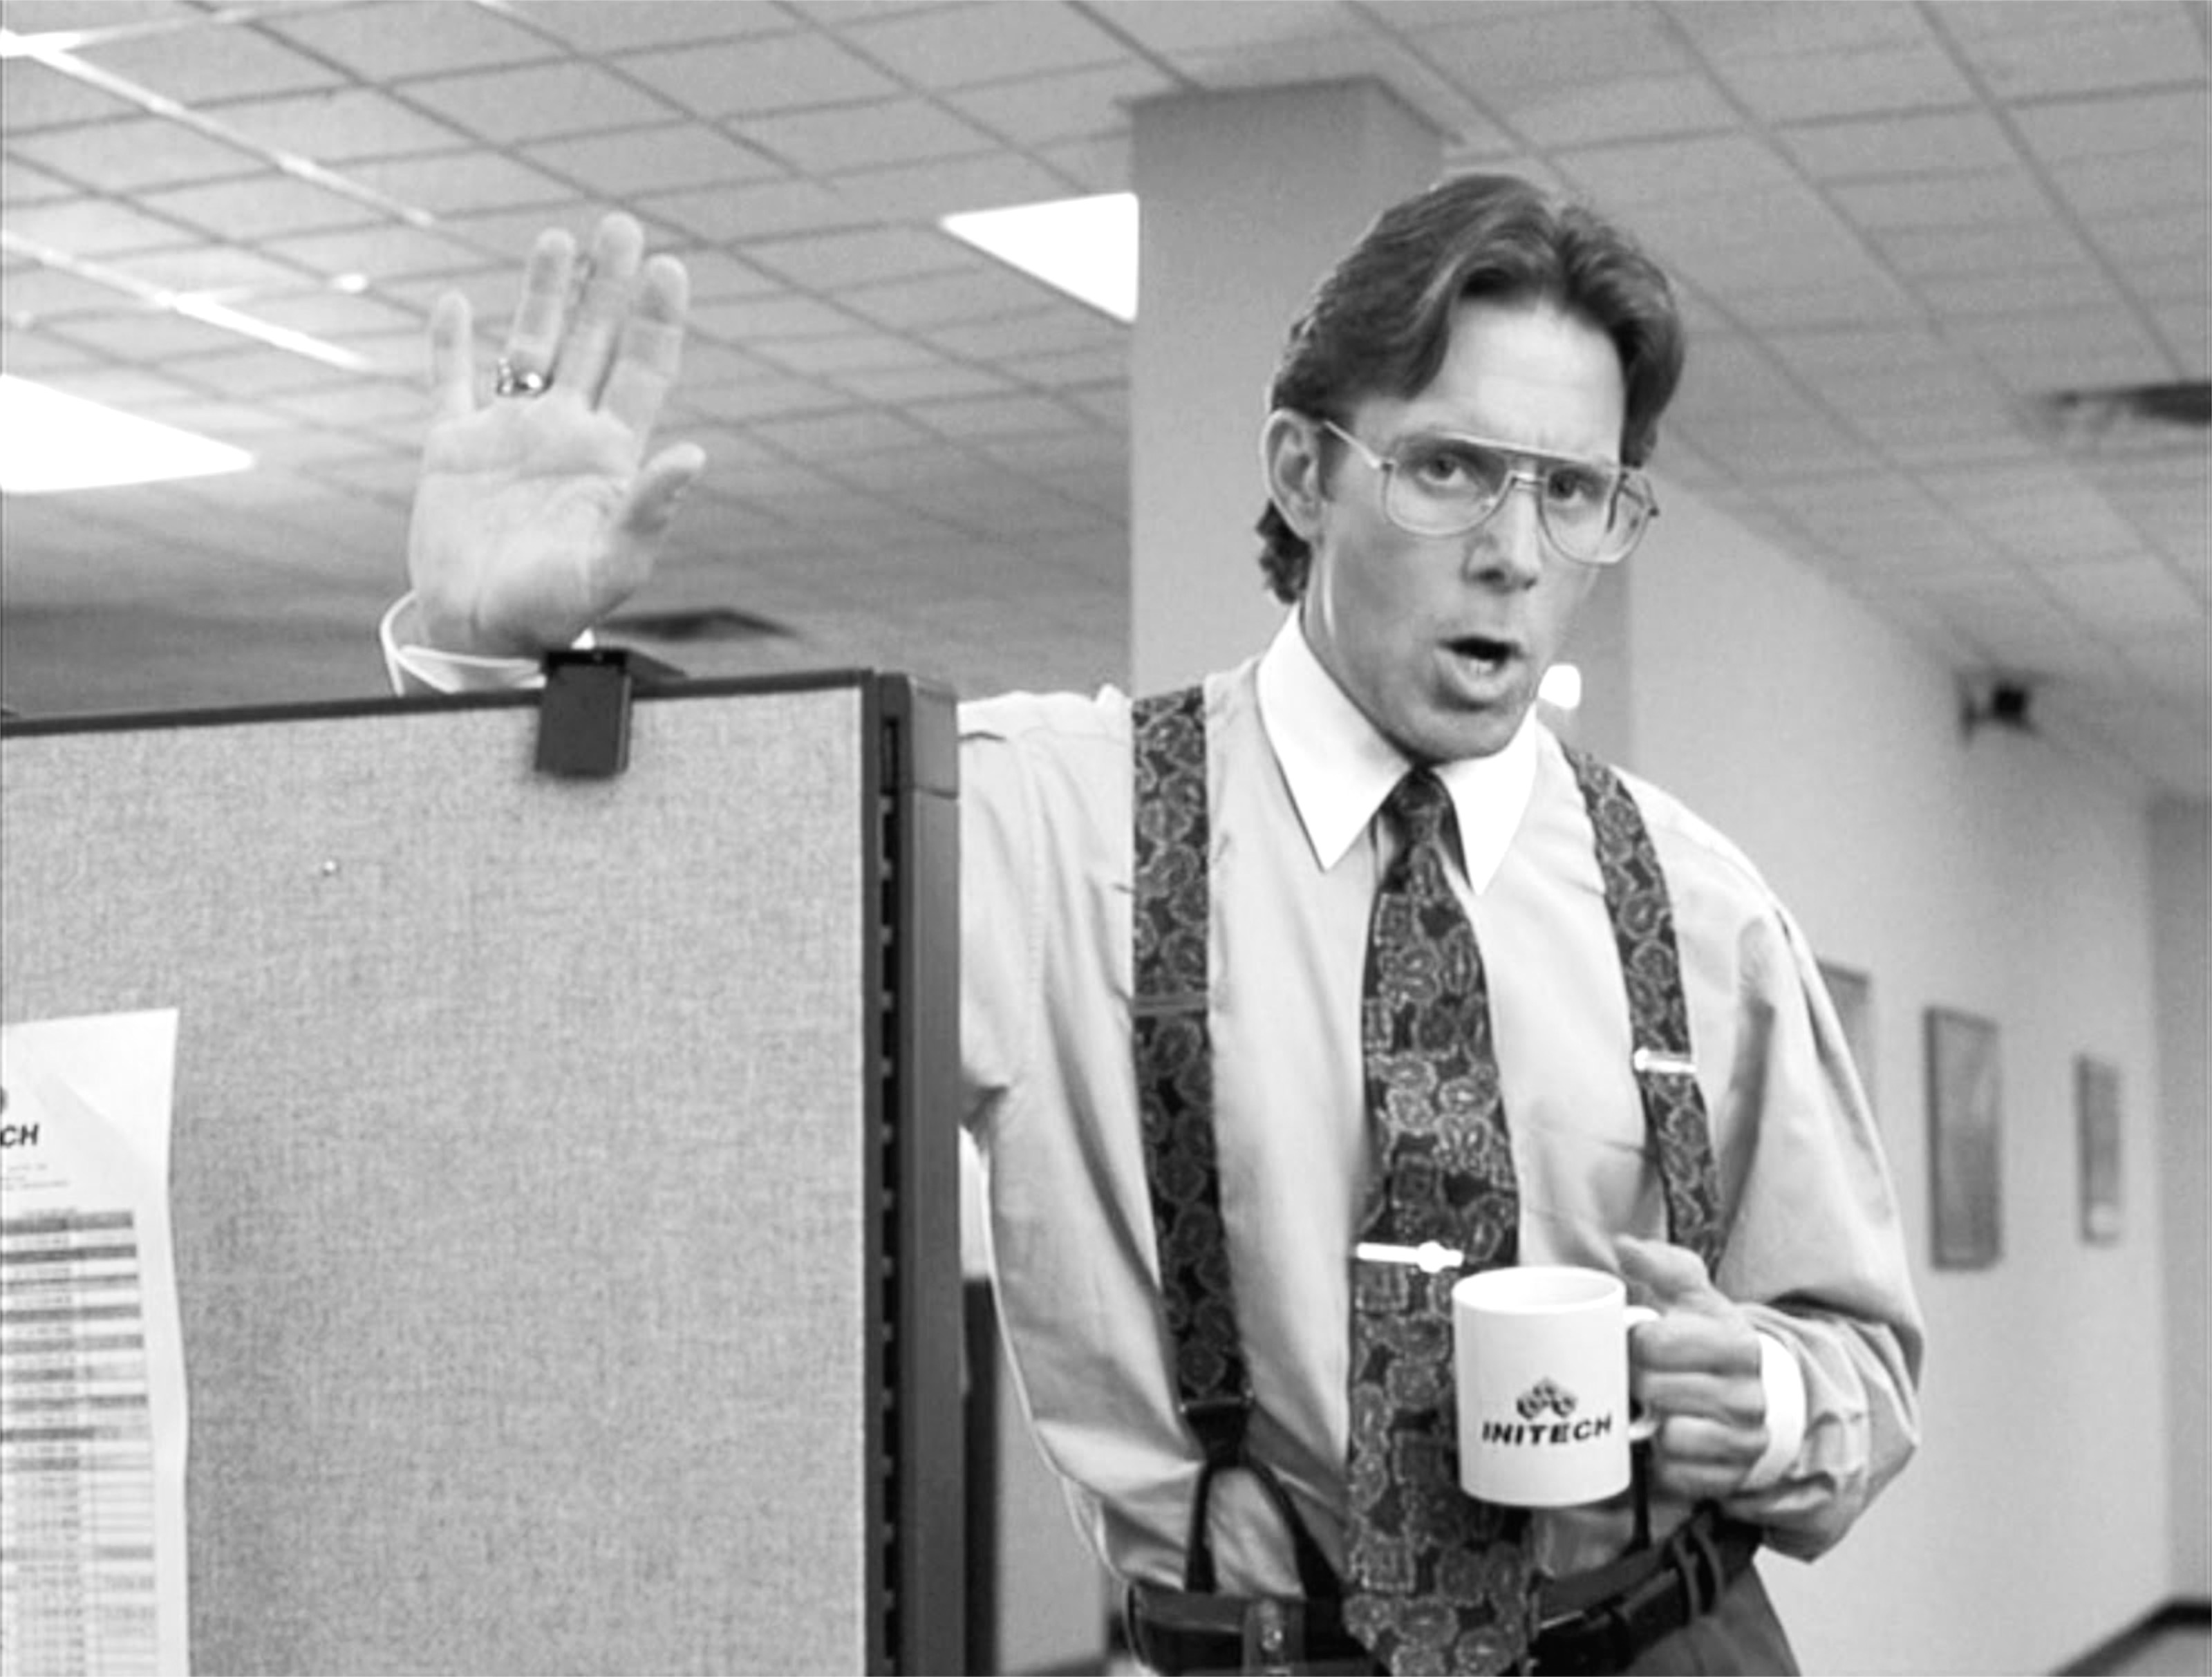
JUST
BETTER
THAN THE
REST OF THE OFFICE
Just one better than everyone else in the office

Slide 27
HOW ARE WE
GOING TO DO
THAT?

Slide 28
GENERATE
MILLIONS OF
BRACKETS

Slide 29

FILTER “BAD” BRACKETS

Slide 30
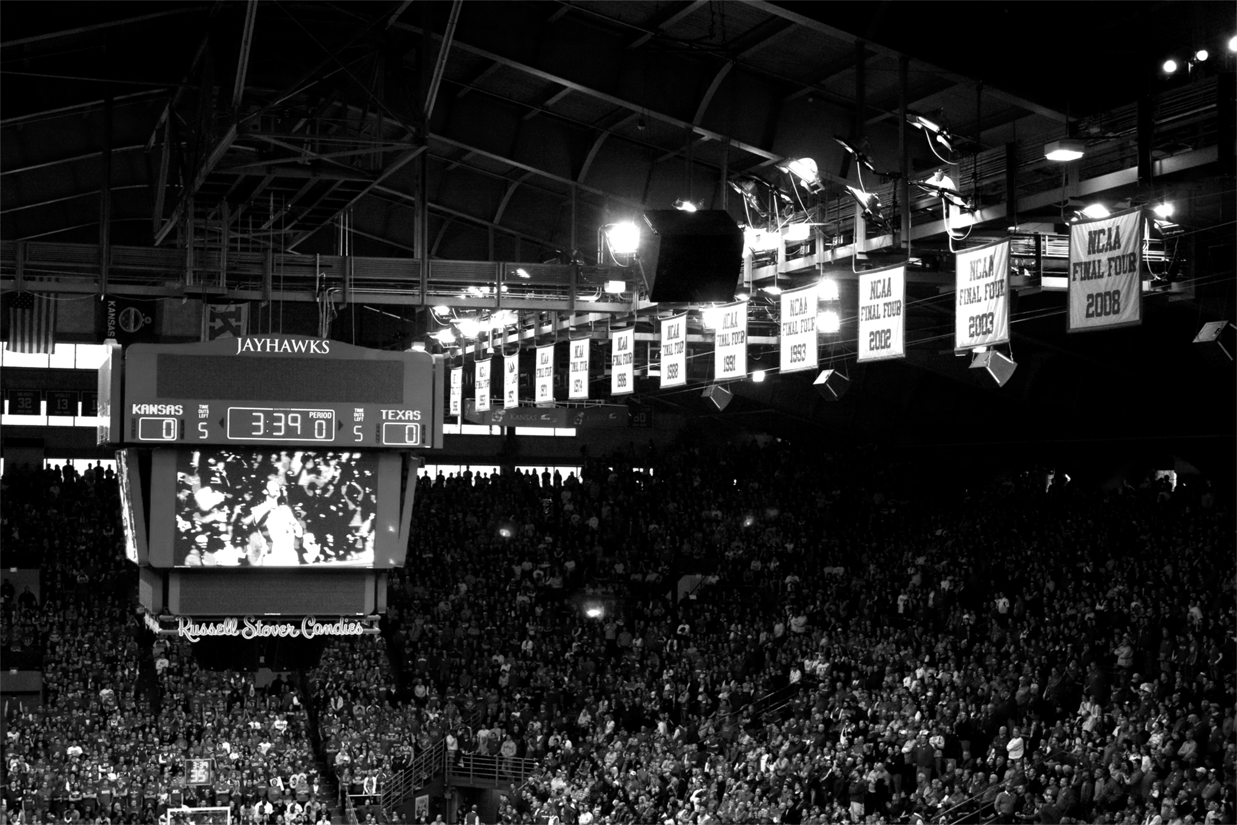
SCORE
THE
REMAINING

Slide 31
HOW
DO WE DO THIS?

Slide 32

Spring Batch!

Slide 33

BATCH ISN’T
IDEAL
Not ideal
Notes:
https://www.flickr.com/photos/donnieray/9436653177

Slide 34
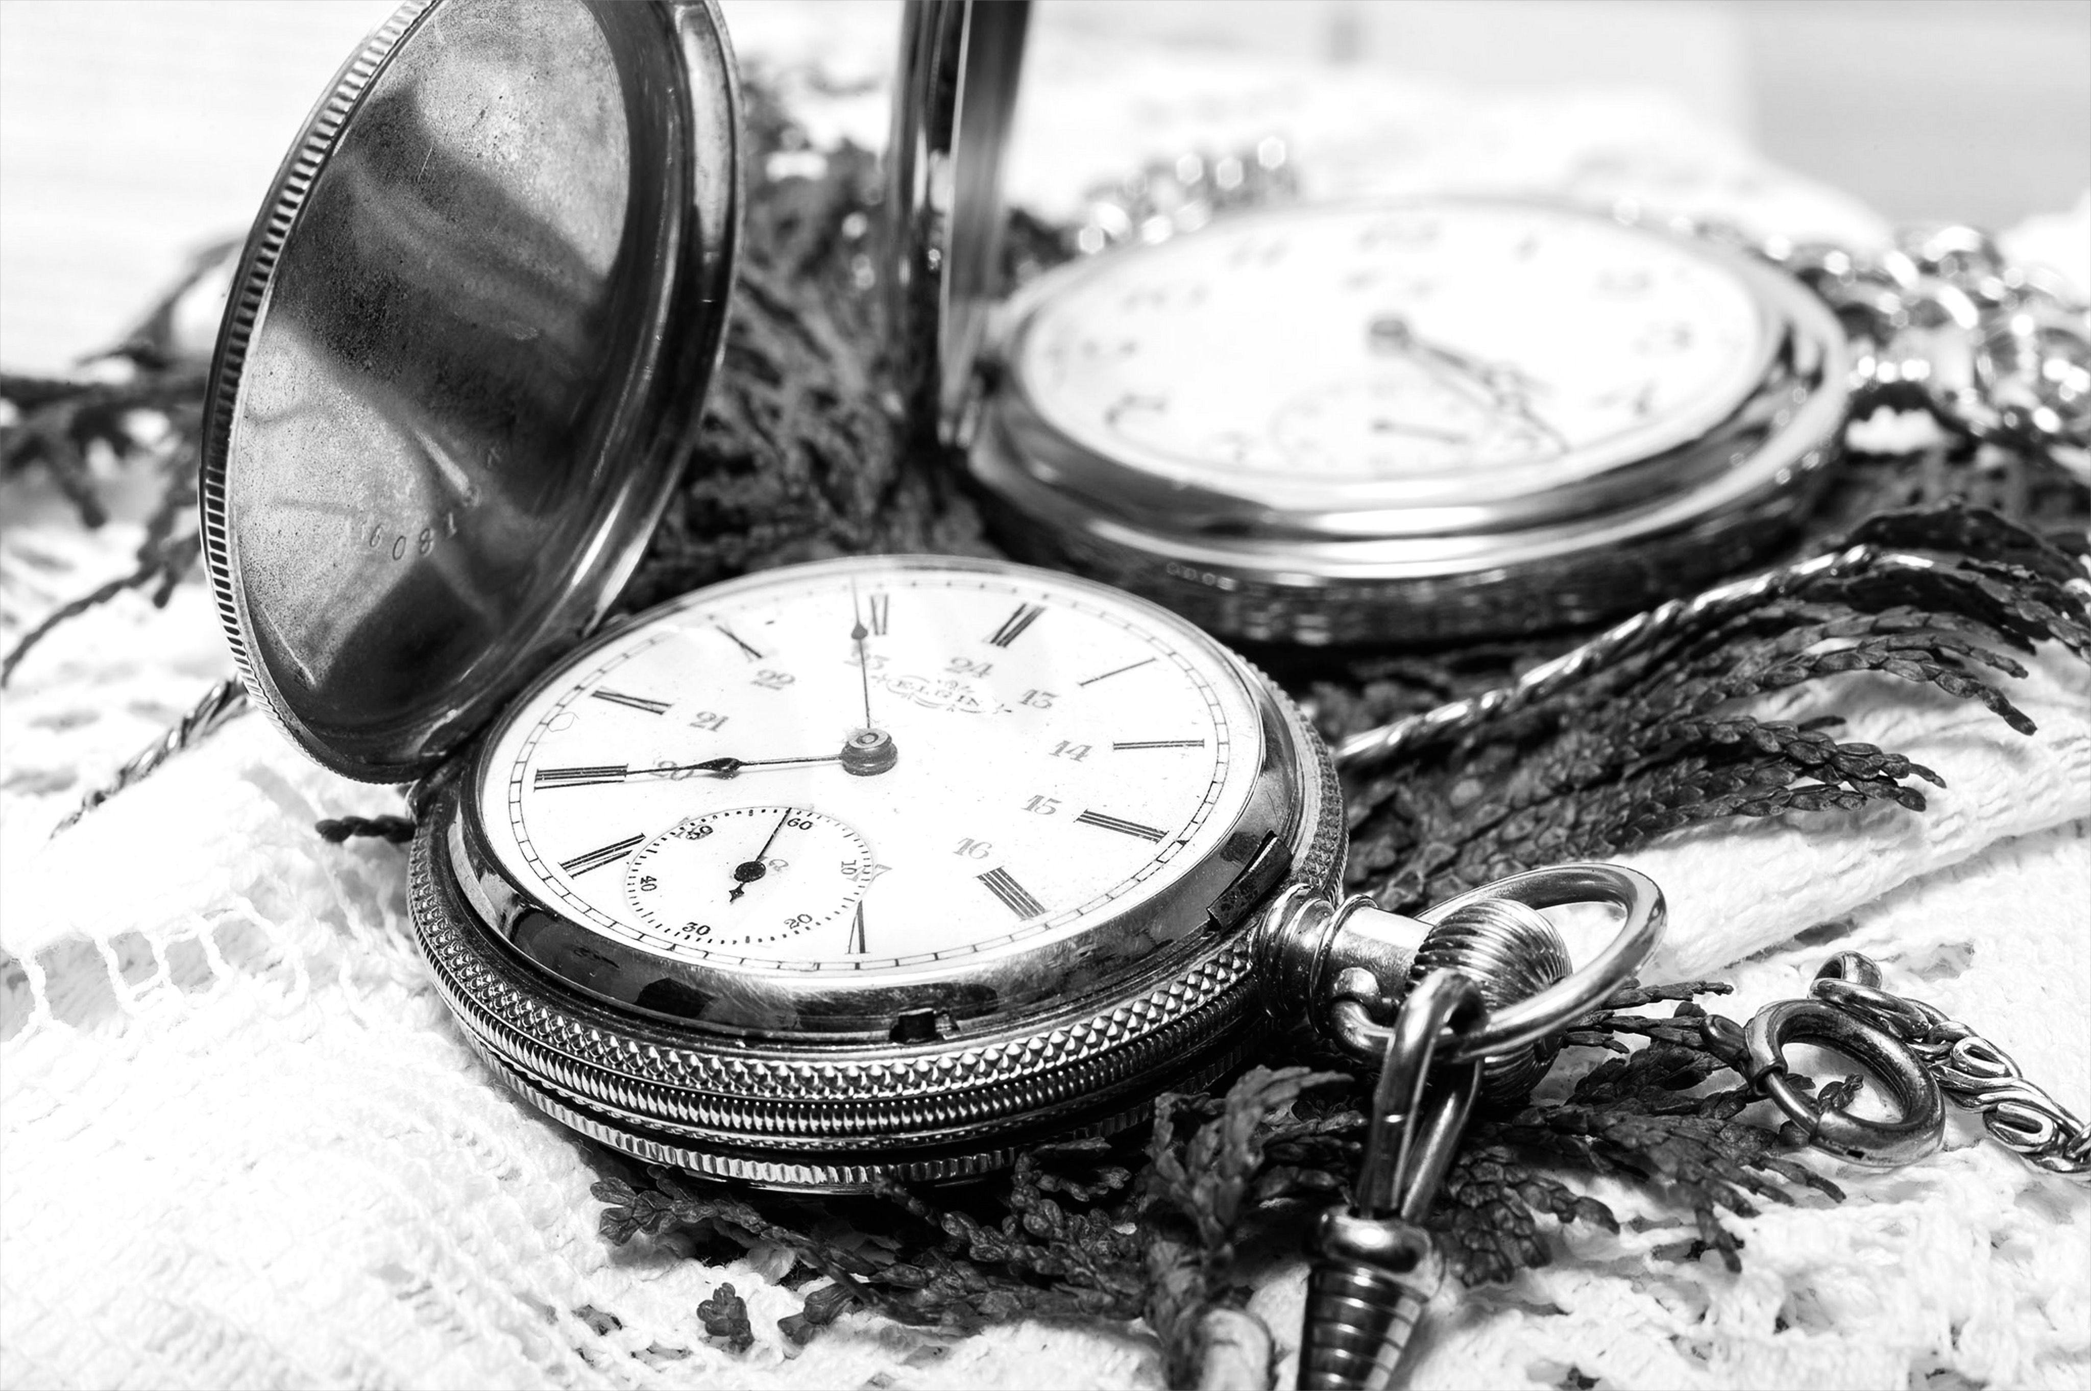
TASKS RUN AT DIFFERENT TIMES
Notes:
https://www.flickr.com/photos/maybourne/11937207616/

Slide 35
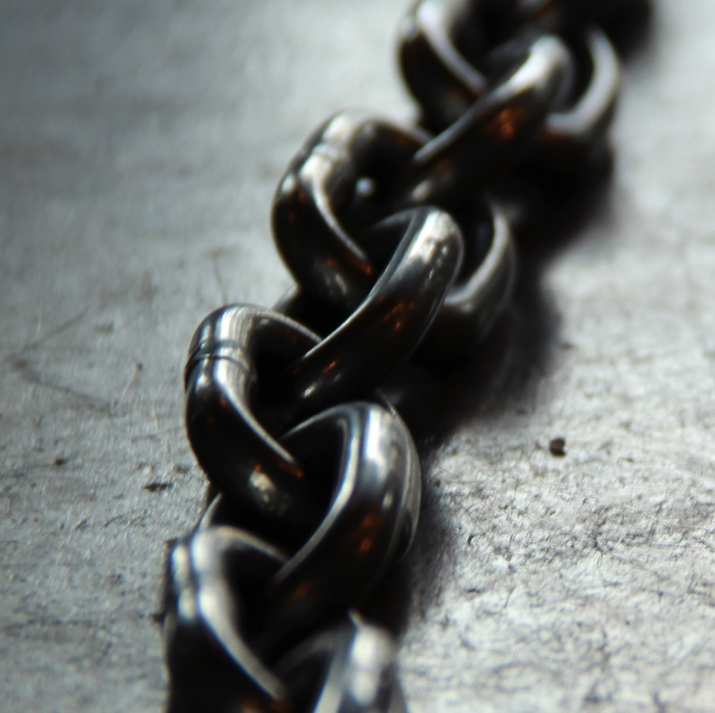
DIFFERENT STEPS
SHOULD BE
DECOUPLED

Slide 36
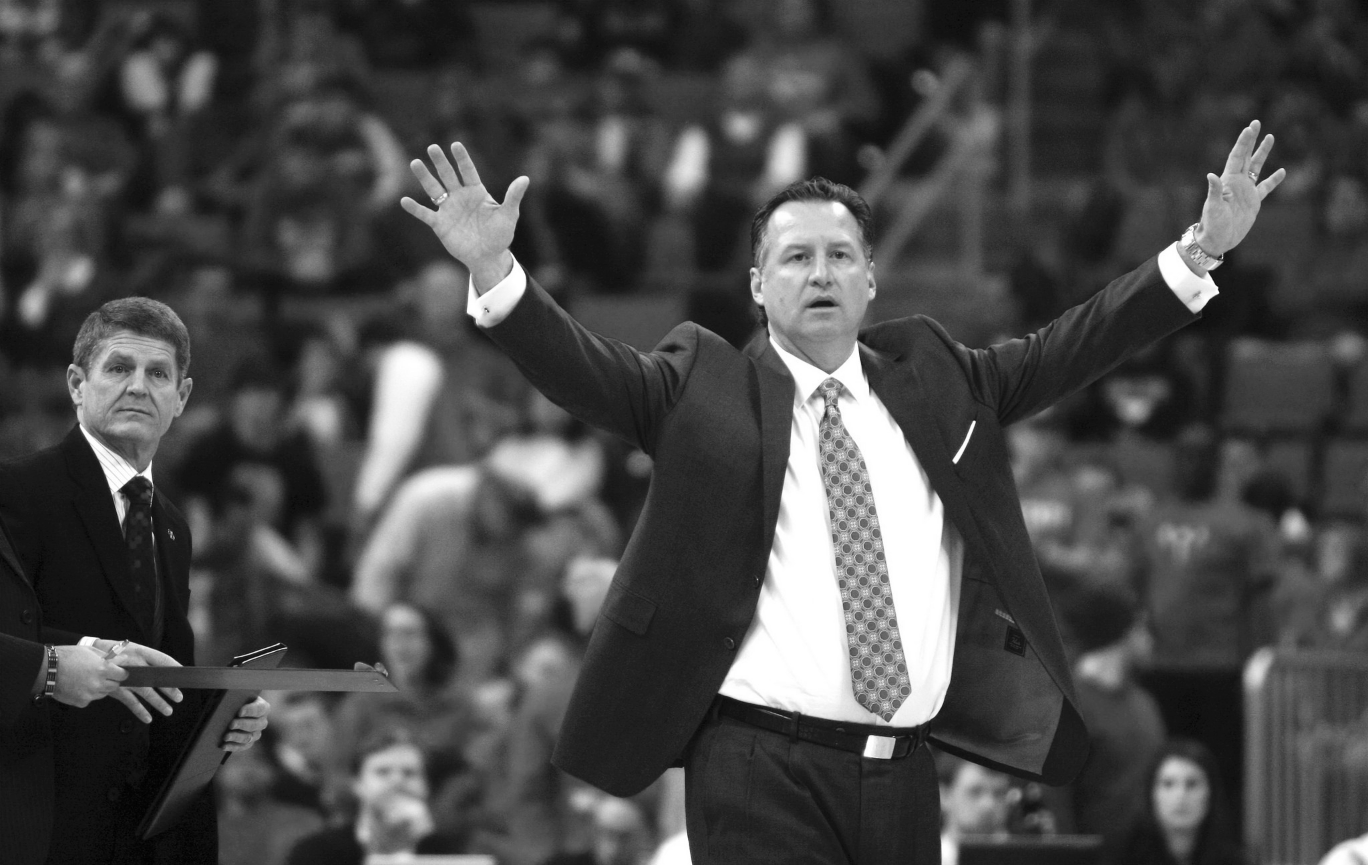
Orchestration should live at a higher level
ORCHESTRATION
OCCURS AT
A DIFFERENT LEVEL

Slide 37
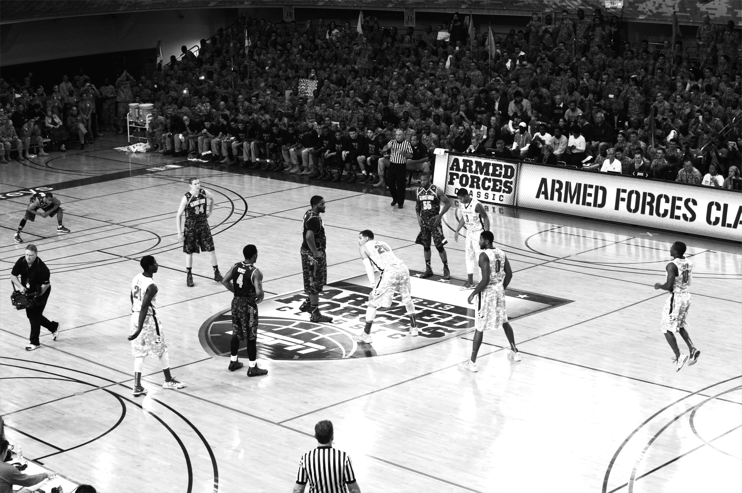
DISTRIBUTED DEPLOYMENT
OPTIONS
Notes:
https://www.flickr.com/photos/usaghumphreys/10917396866/

Slide 38
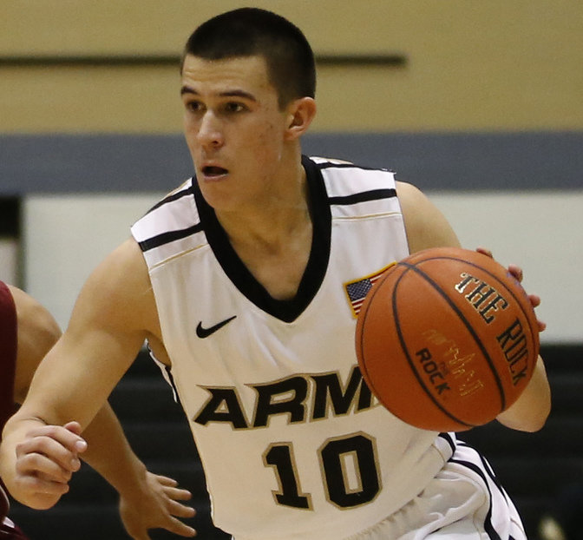
DEVELOP EACH
COMPONENT AS A
MICROSERVICE

Slide 39
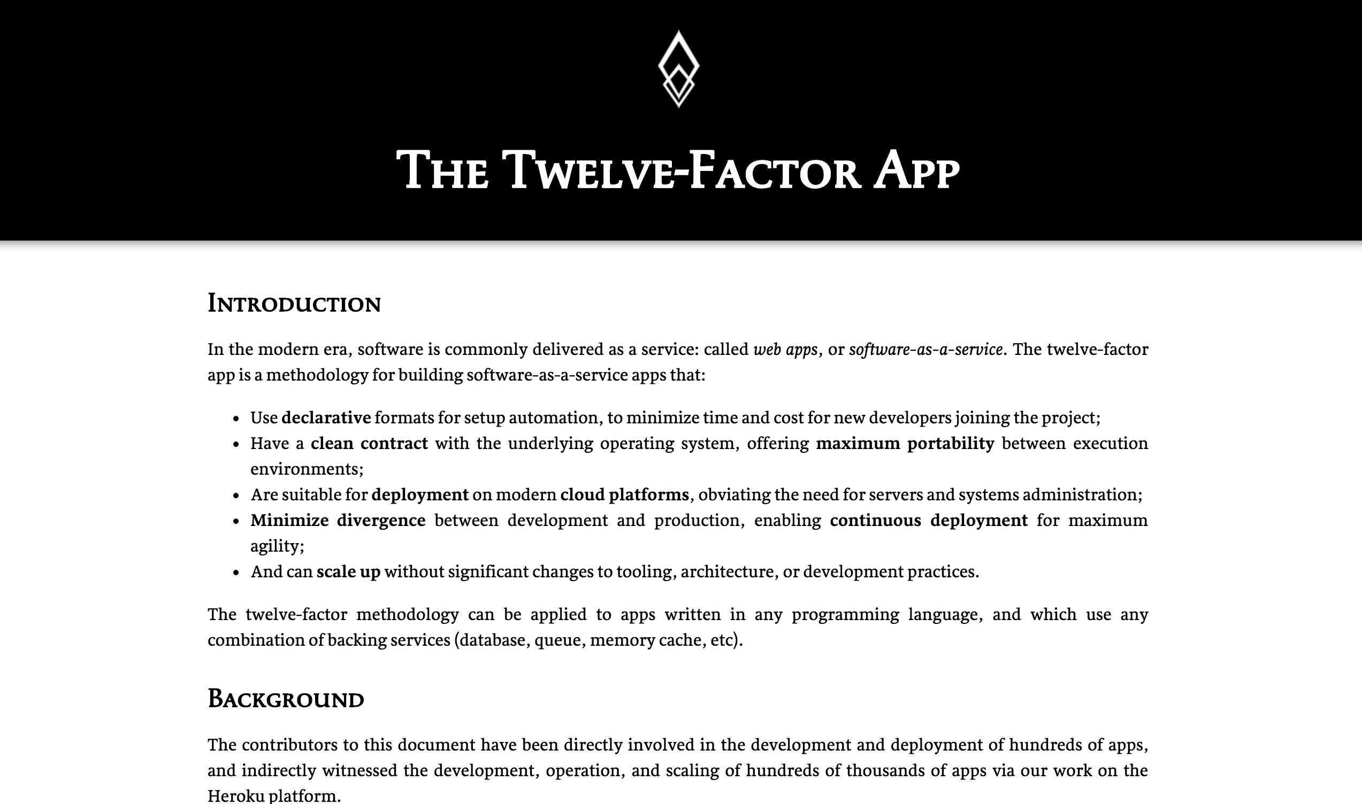
OBEY THE 12
FACTOR APP
PRINCIPALS

Slide 40

There is an ecosystem that’s better
THERE’S
AN ECOSYSTEM
THAT’S BETTER

Slide 41
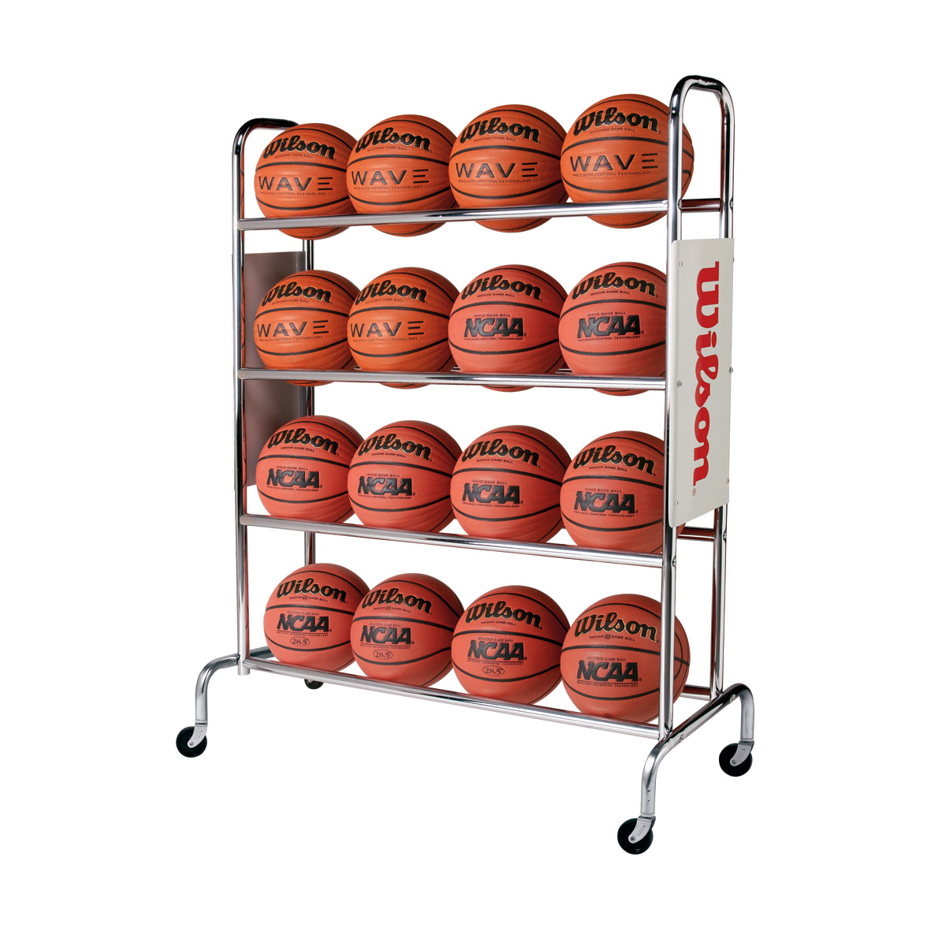
DATA
MICROSERVICES

Slide 42
SPRING CLOUD DATA FLOW
SPRING CLOUD
STREAM
SPRING CLOUD
TASK
SPRING
INTEGRATION
SPRING
BATCH
SPRING FRAMEWORK

Slide 43
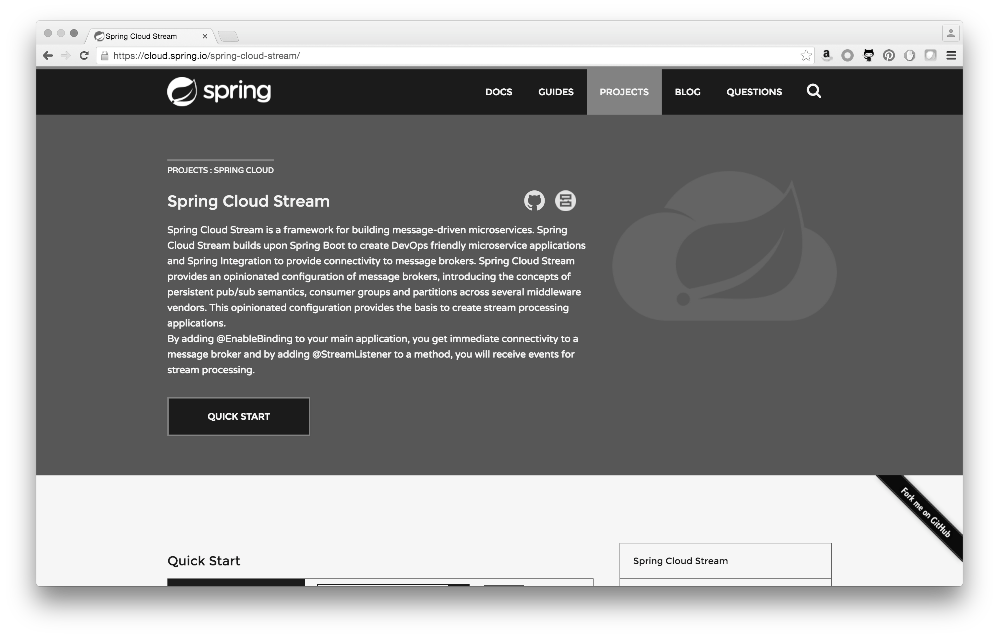
SPRING
CLOUD
STREAM

Slide 44
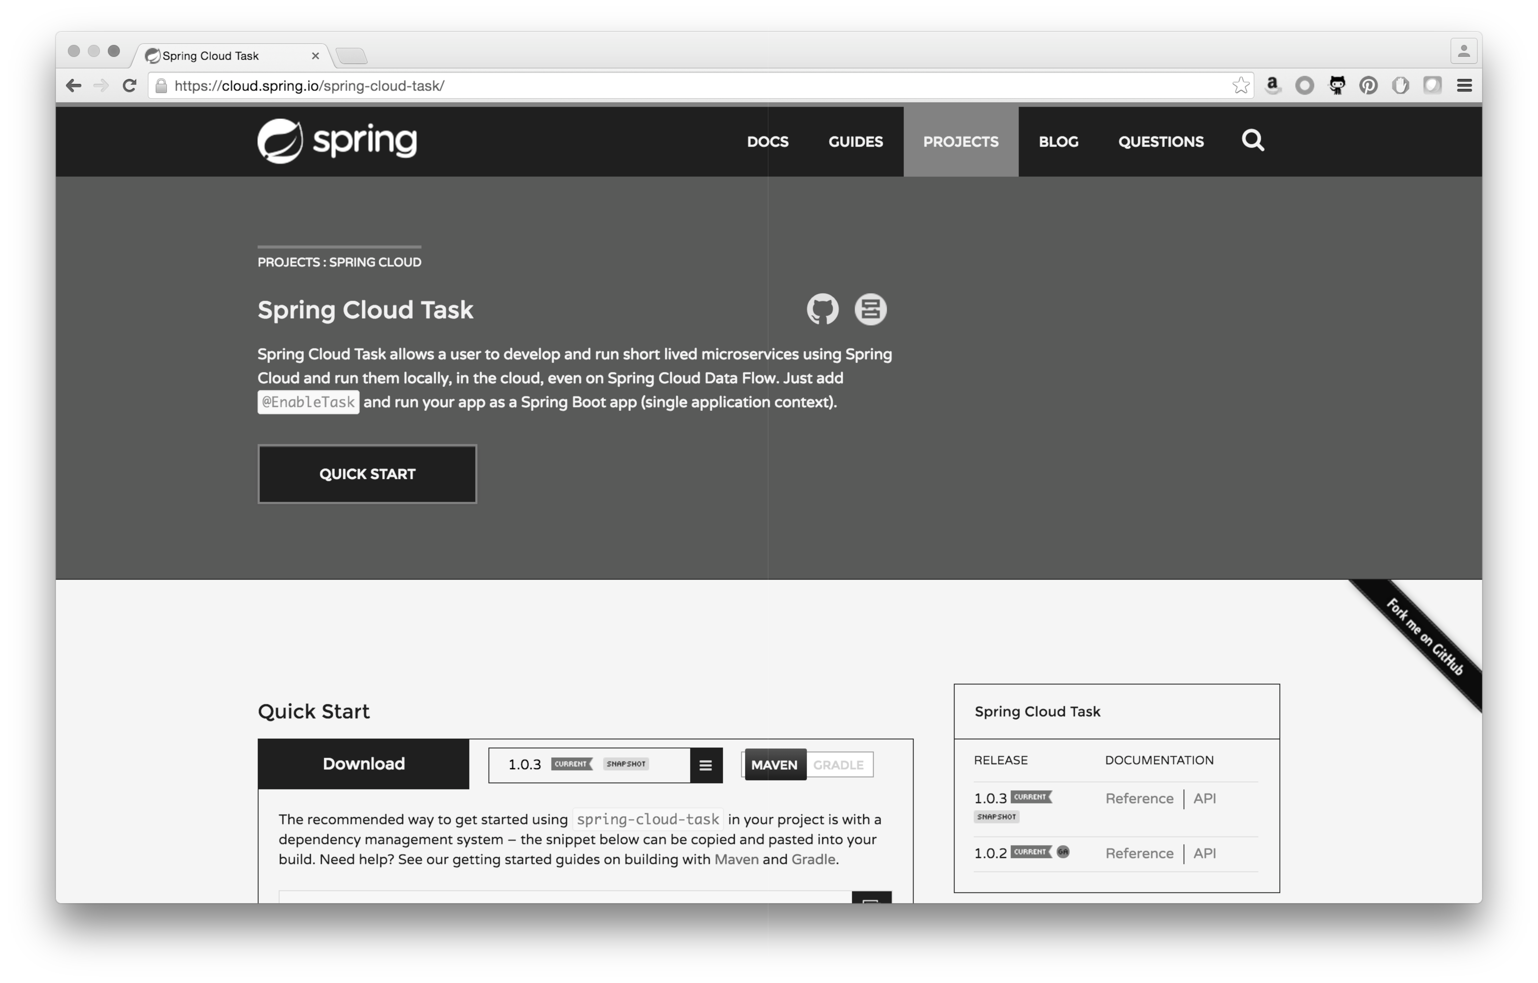
SPRING
CLOUD
TASK

Slide 45
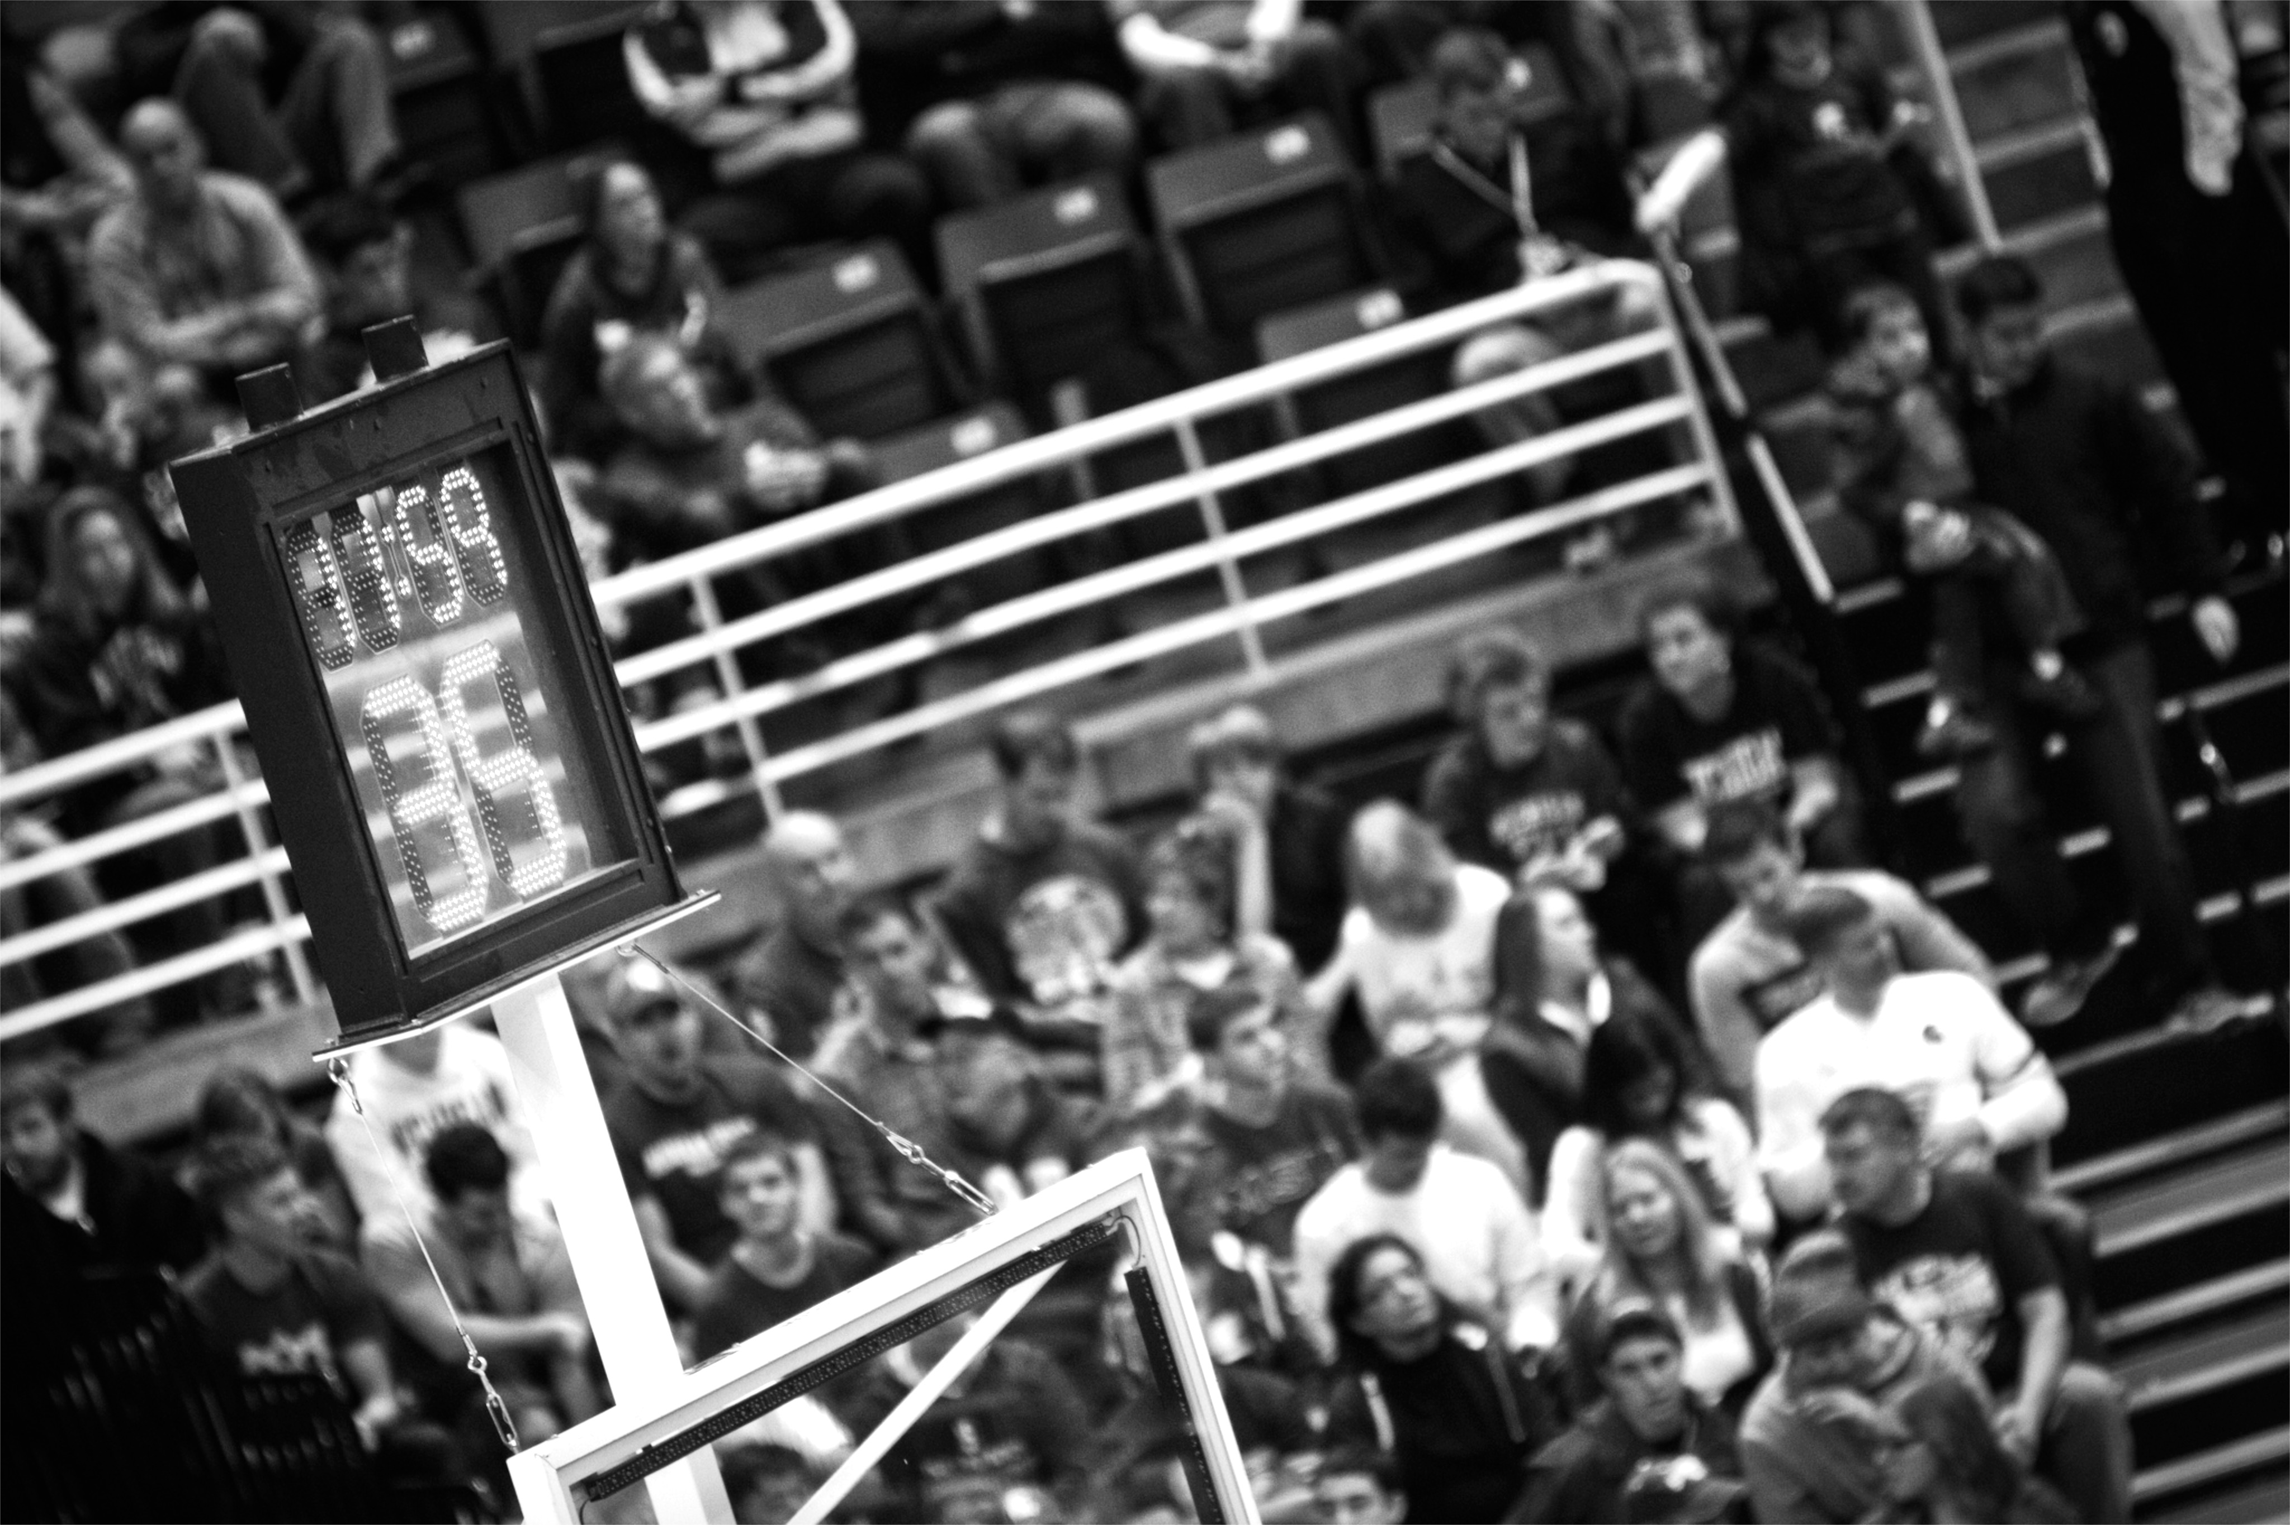
JUST
SHORT LIVED
Notes:
https://www.flickr.com/photos/maybourne/11937207616/

Slide 46

A framework for providing functional and nonfunctional features
for building short lived microservices.

Slide 47
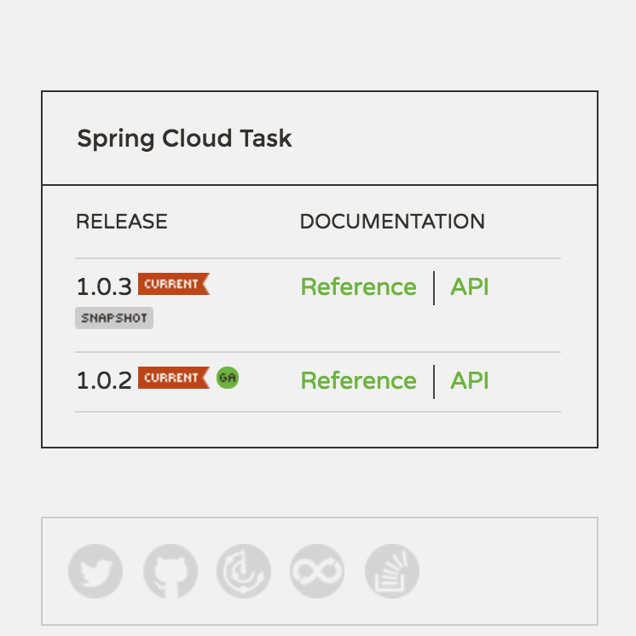
CURRENT VERSION
1.0.2.RELEASE

Slide 48
FEATURES

Slide 49
1
EXECUTION TRACKING

Slide 50
2
BATCH INTEGRATION

Slide 51
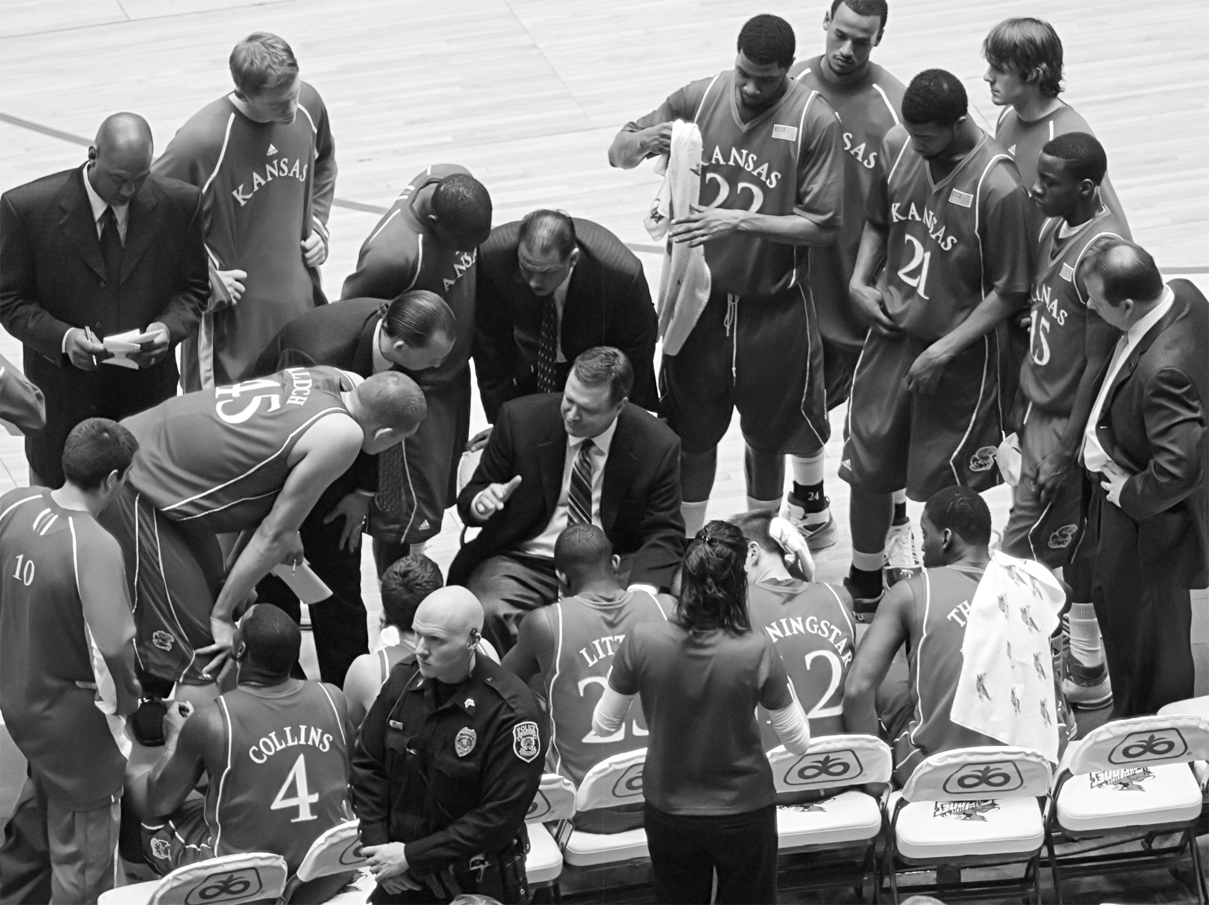
INFORMATIONAL
MESSAGES

Slide 52
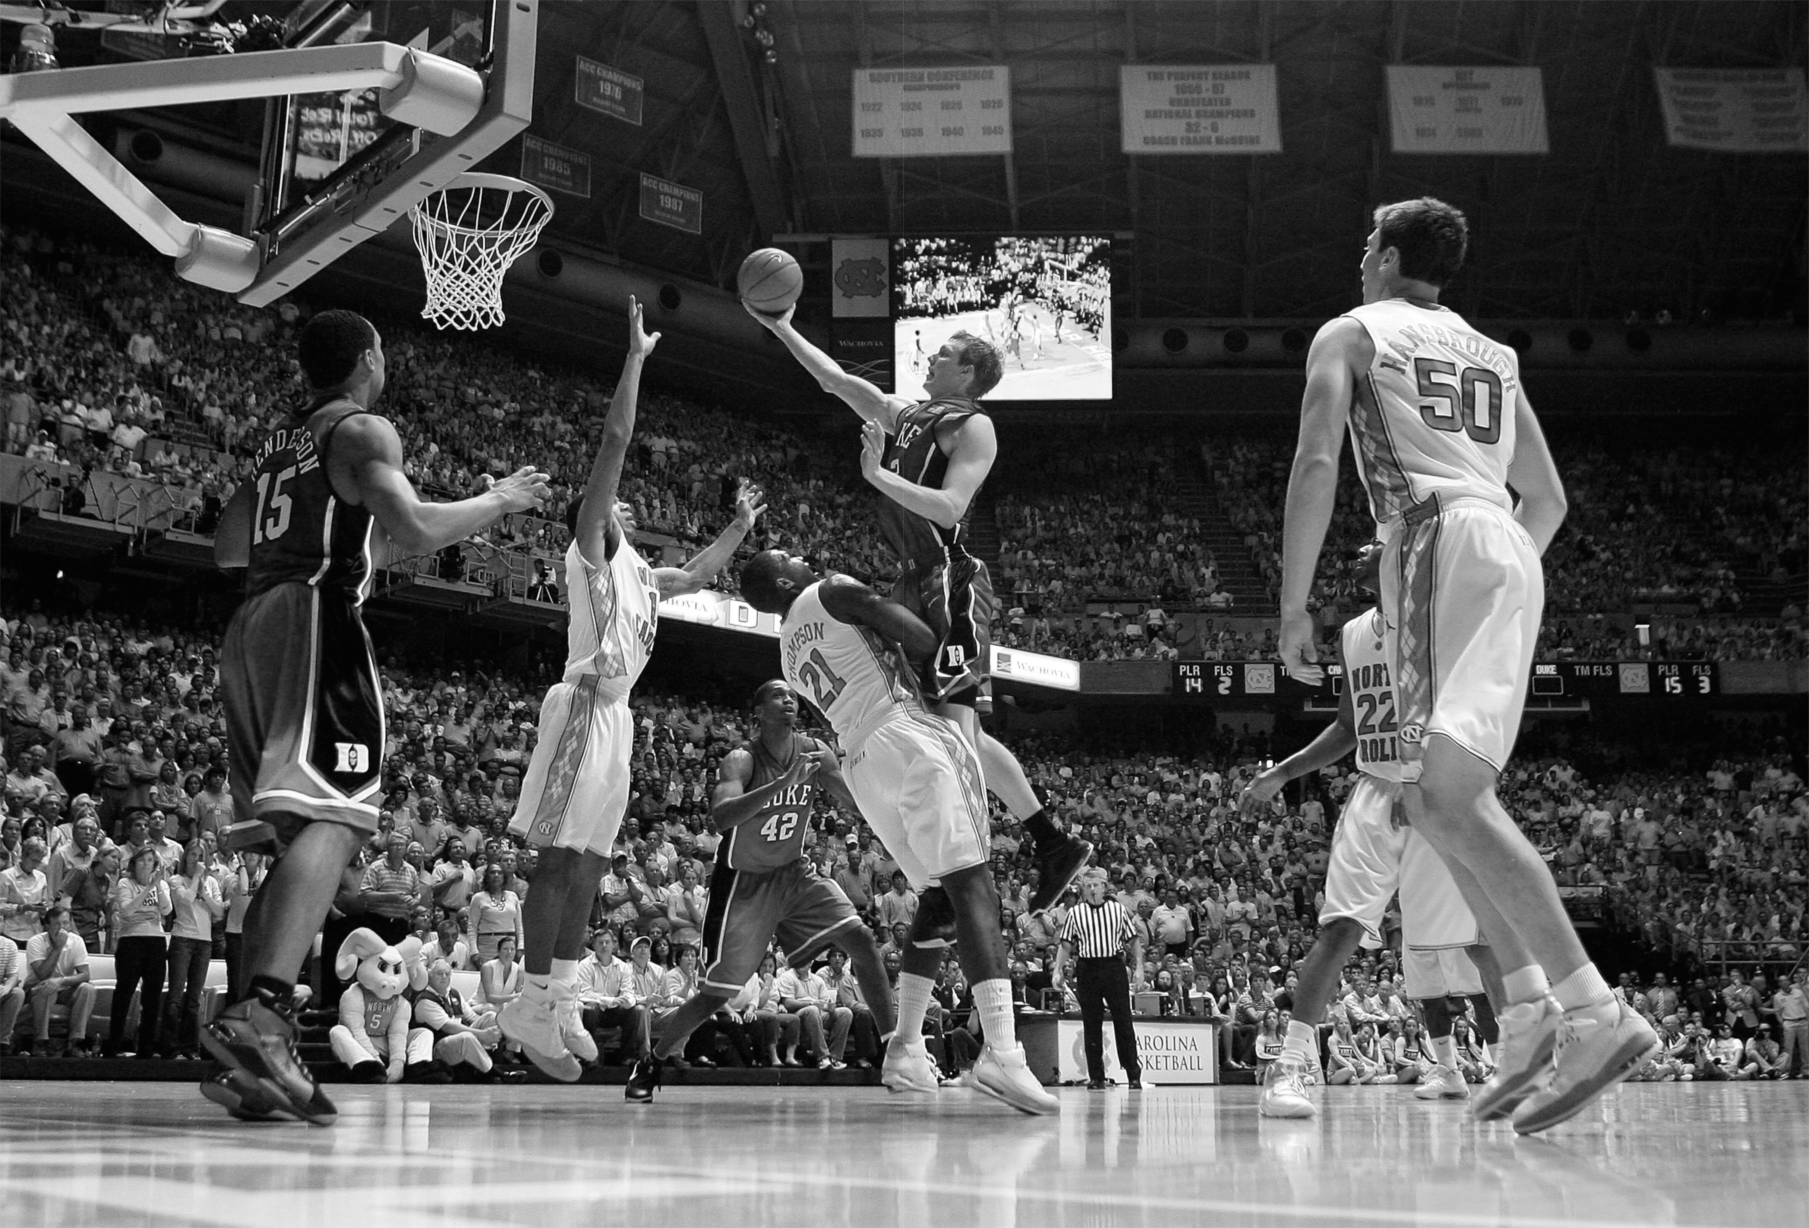
REMOTE
PARTITIONING

Slide 53
3
STREAM INTEGRATION

Slide 54
INFORMATIONAL
MESSAGES

Slide 55
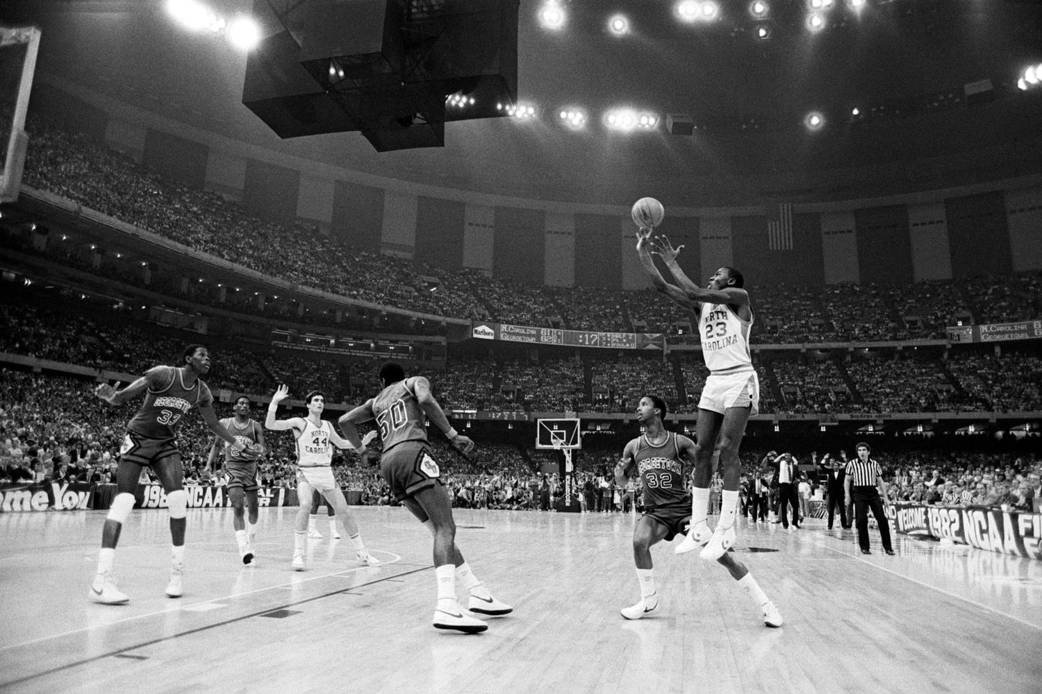
LAUNCHING
VIA STREAM

Slide 56
SO HOW DOES
THIS WORK?

Slide 57

TAKE A SPRING
BOOT APPLICATION

Slide 58
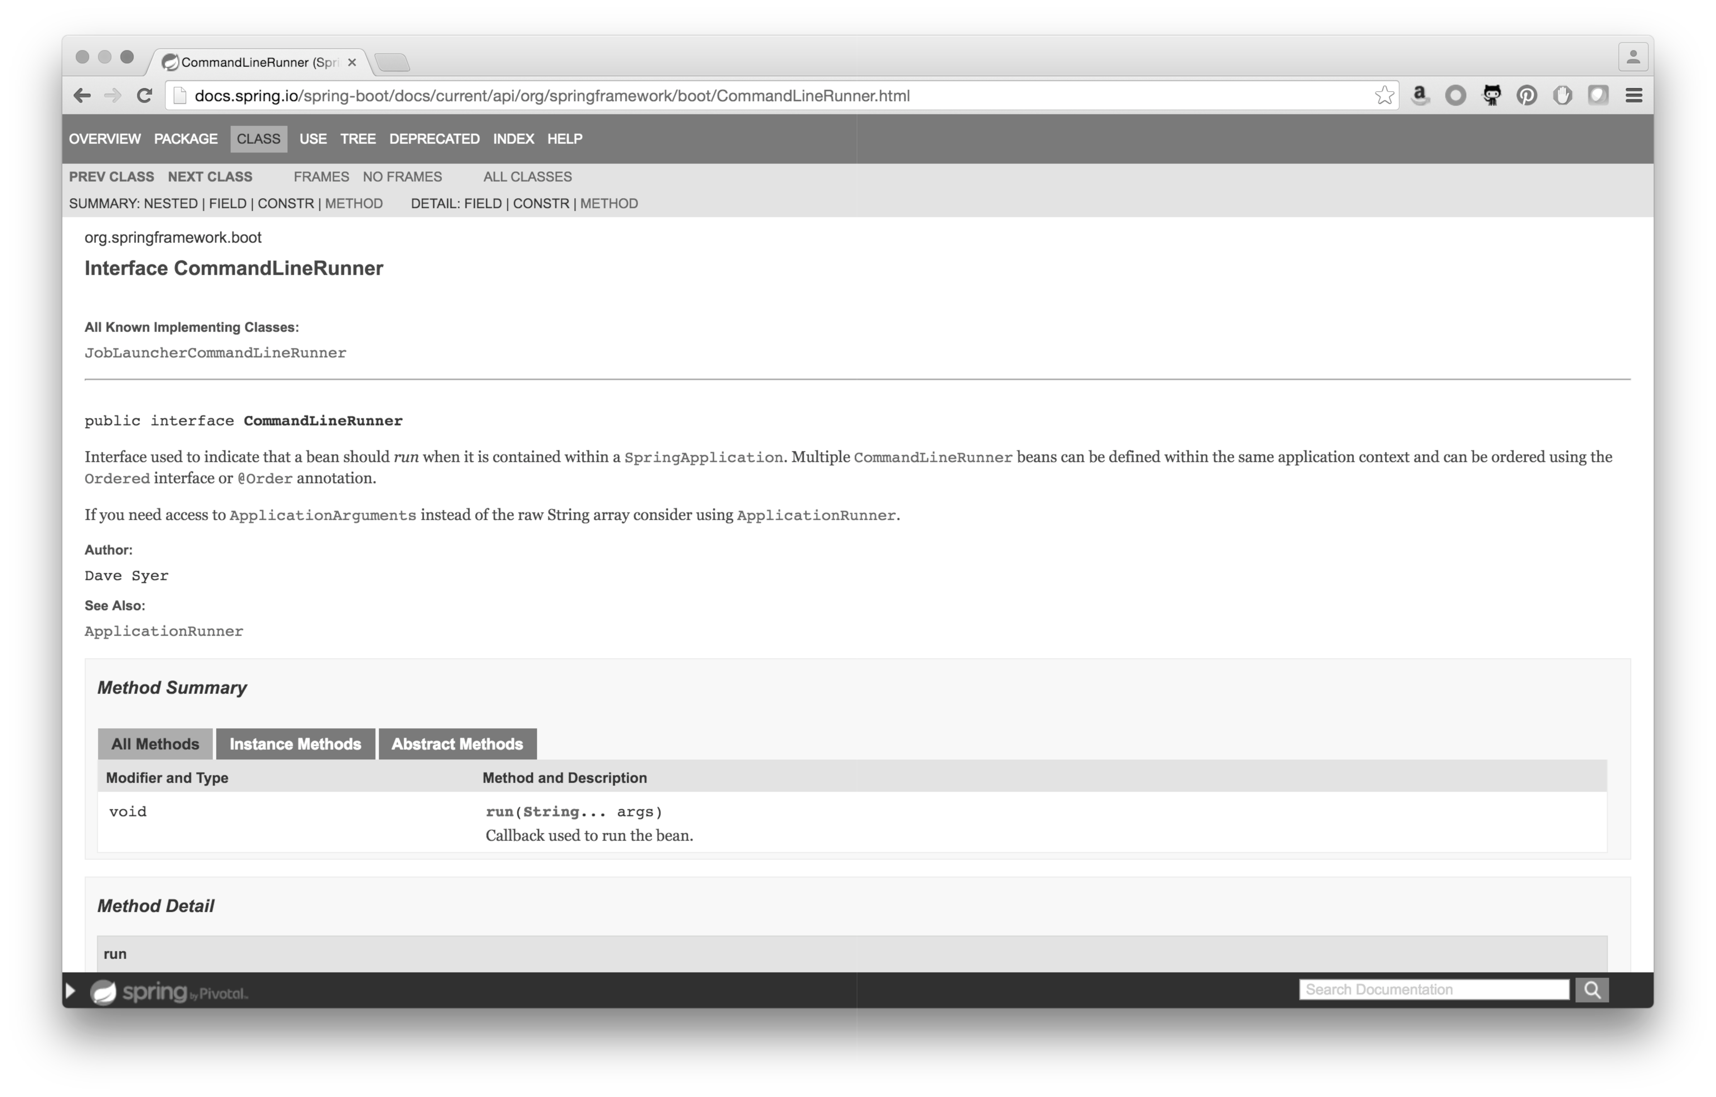

Slide 59
@EnableTask

Slide 60
START
TASK
END
TASK
COMMAND
LINERUNNER
APPLICATION
RUNNER
COMMAND
LINERUNNER

Slide 61
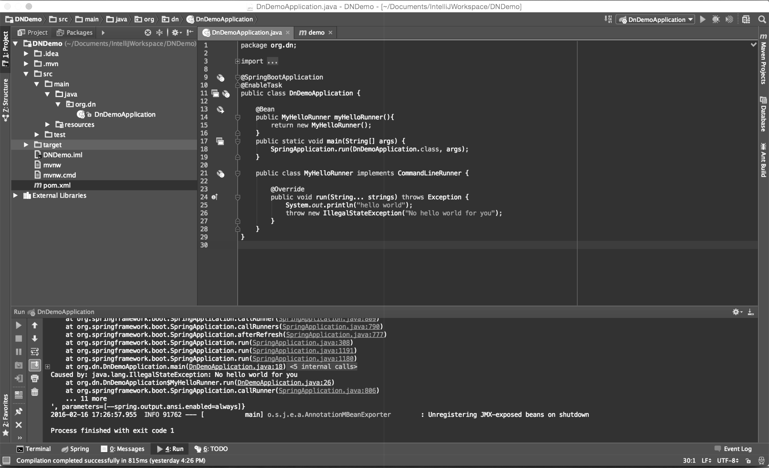
HELLO
WORLD!
Hello World of Spring Cloud Task

Slide 62
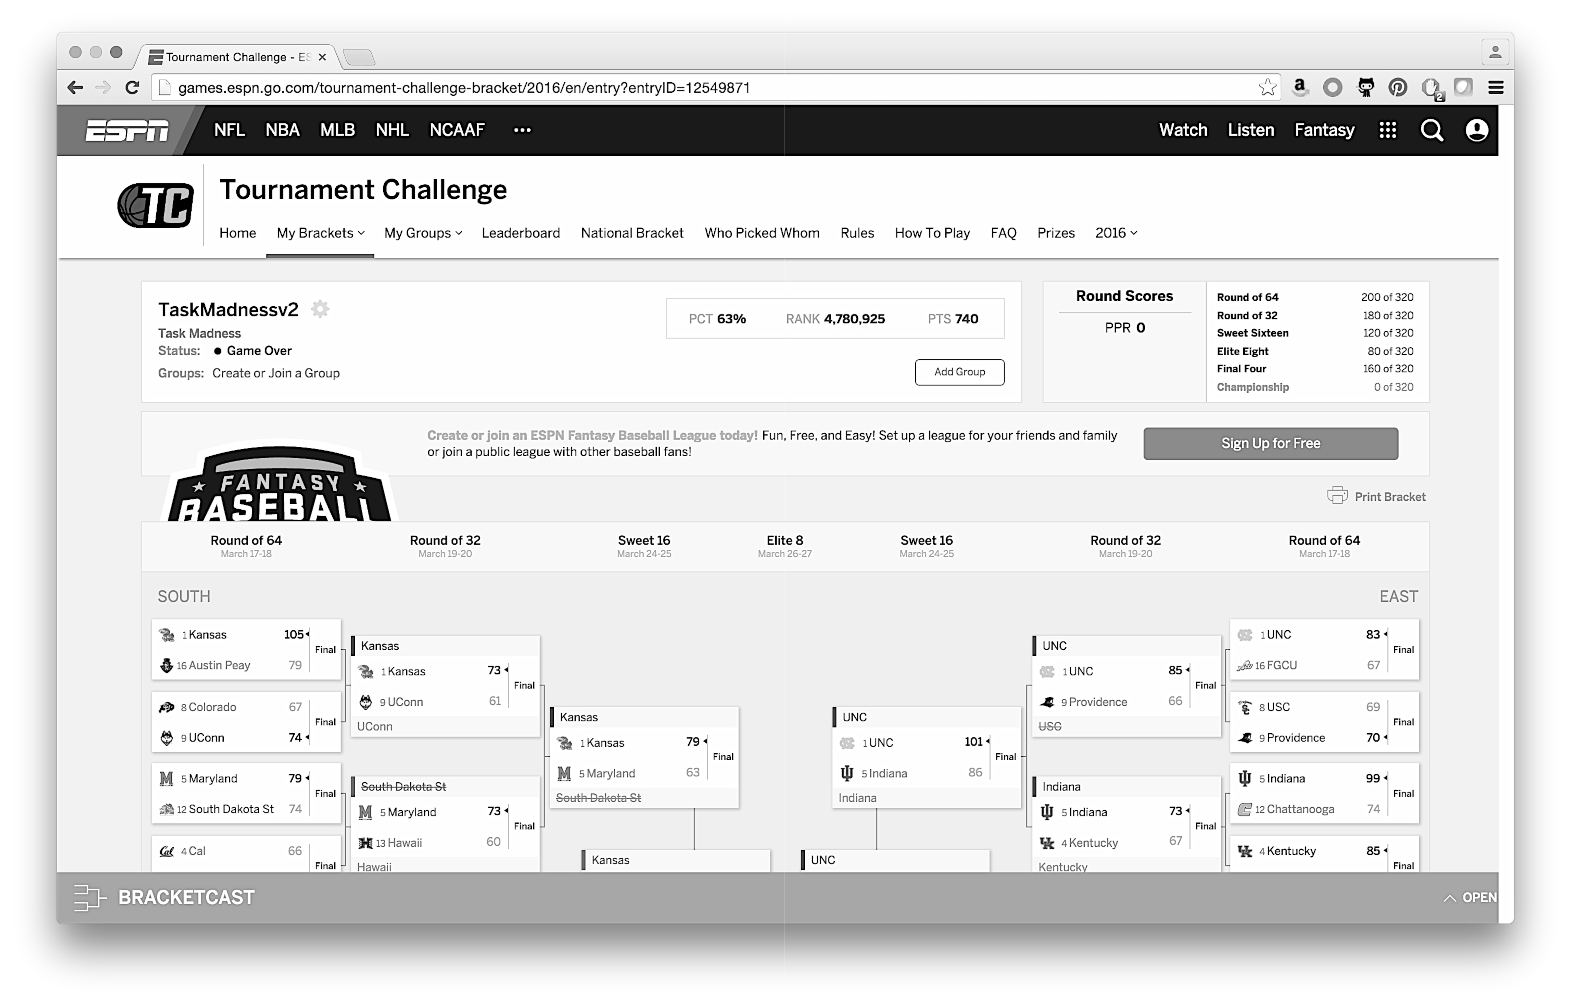
BRACKET
GENERATION

Slide 63

LOADERS
LOADERS
LOADERS
FILTER
TASK
LAUNCHING
PROCESSOR
TASK
LAUNCHING
SINK
SCORER
BRACKET
GENERATOR

Slide 64
Demo
DEMO

Slide 65
SO HOW DID
WE DO?

Slide 66
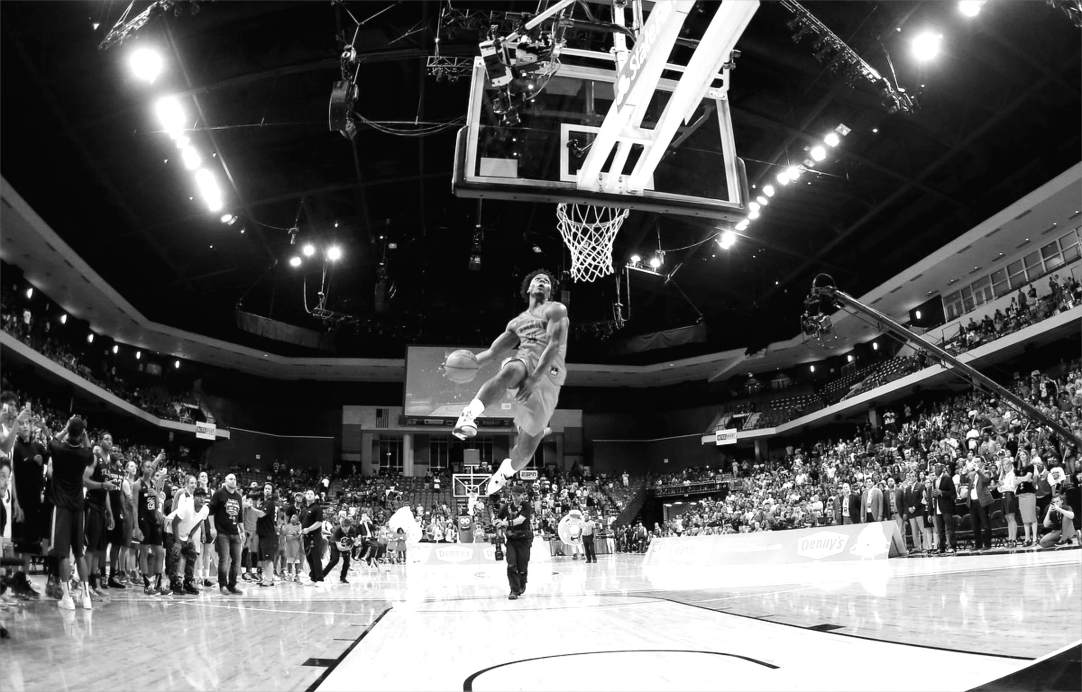
GOAL:
800 OR 80%
Goal: 800 pts or 80%

Slide 67
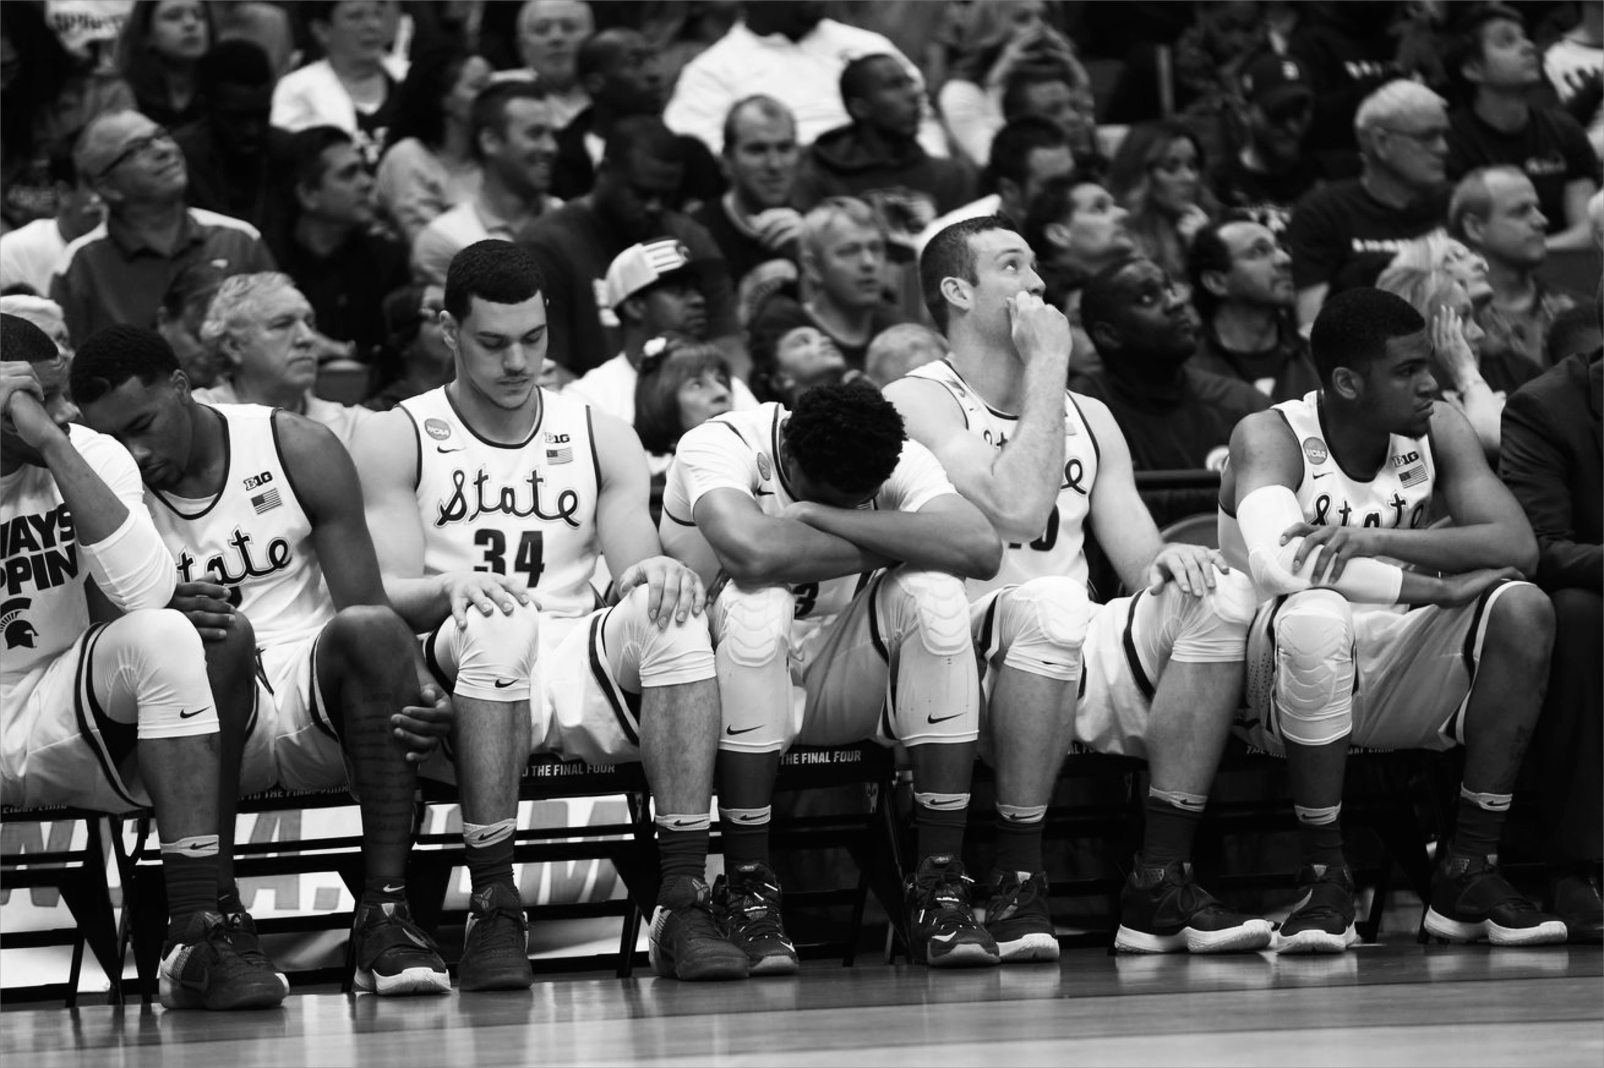
TOP 5
YEAR FOR
UPSETS
Upset heavy year

Slide 68
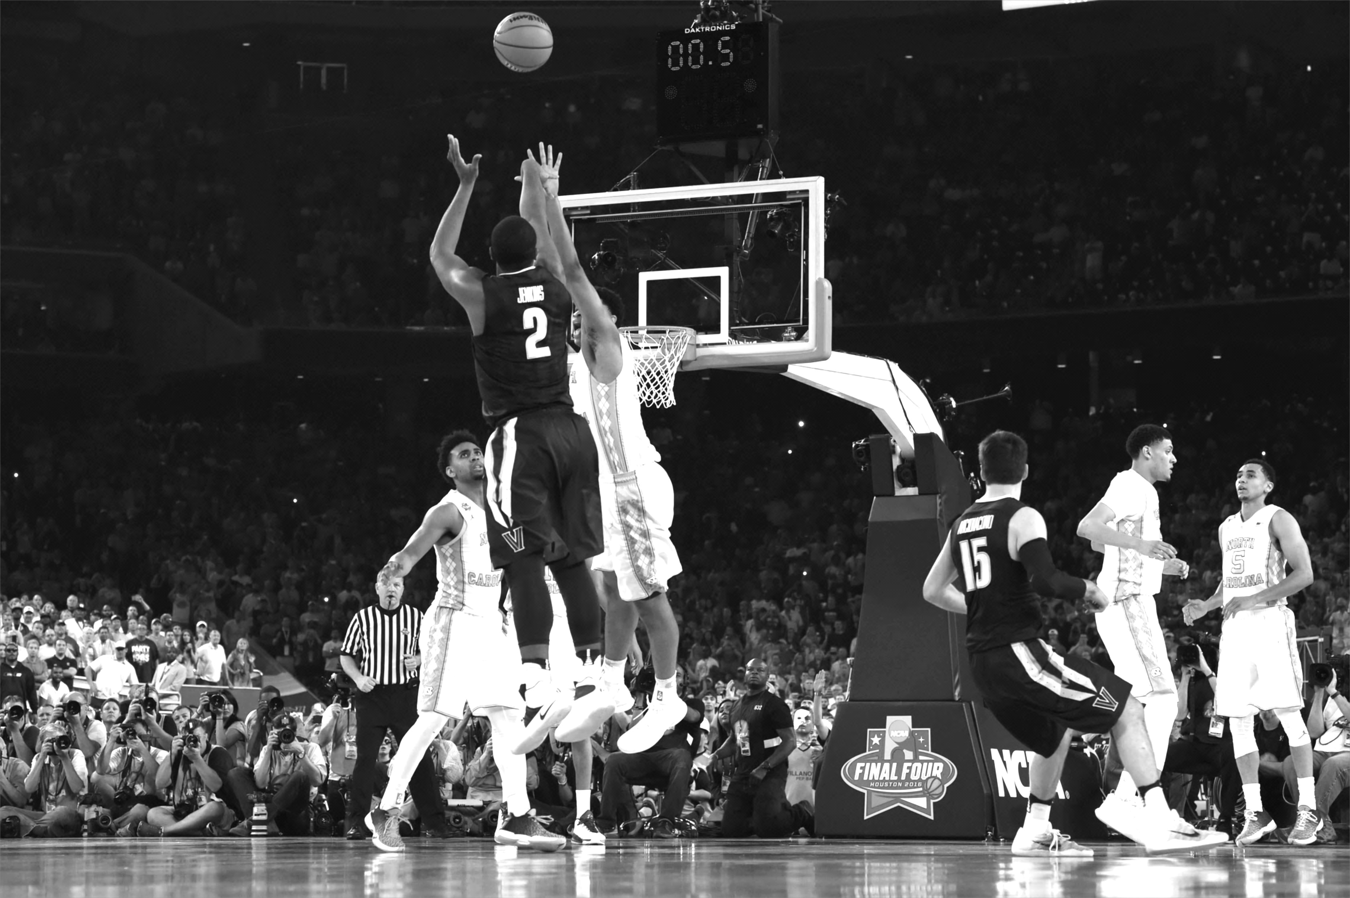
0.5 SECONDS

Slide 69
740 pts/63%
63%
740 PTS
Notes:
Buzzer beater by Vilanova caused our defeat in what is considered one of the most competitive finals in NCAA history.

Slide 70
ROADMAP

Slide 71
1
IMPROVED
ORCHESTRATION

Slide 72
2
OUT OF THE BOX TASKS

Slide 73

QUESTIONS?

Slide 74
THANKS!

